Slide 1

Charles Darwin,
Evolutionary Thought, and
the Evidence for Evolution

Slide 2



I. Evolution and Its Core Principles (Section 16.1)
  A. Evolution is a central theme in biology; it explains many riddles about striking similarities and astonishing differences seen in the form, function, behavior, and ecology of living things.

Slide 3

III. Evolutionary Thinking before Darwin
  A. Rapid advances in new field of geology (spurred by need to find coal and iron to fuel Industrial Revolution) set stage for Darwin’s ideas.

Slide 4
Uniformitarianism
“The laws of nature are same today as always”.
Therefore, the same kind forces that are operating today have always operated on the Earth
e.g. decomposition, erosion, deposition

Slide 5

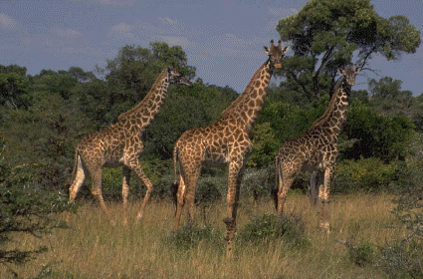
  III. Evolutionary Thinking before Darwin
  B. Notions advanced by other biologists have influence:
    2. Lamarck’s ideas about inheritance of acquired characteristics were wrong, but notion of change in organism over time was sound.

Slide 6




  B. Notions advanced by other biologists have influence:
    1. On voyage, reads Lyell’s Principles of Geology; stressed antiquity of Earth’s history and its continual shaping by natural forces (evolution of land forms).

Slide 7
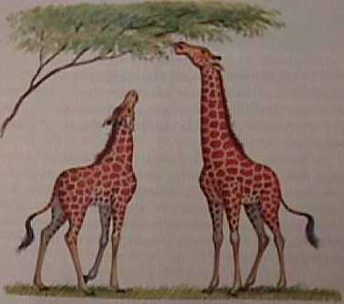
Jean Baptiste Lamarck
Use and Disuse
Inheritance of Acquired Characteristics

Slide 8

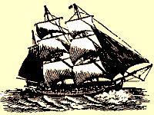
Charles Darwin and the Theory of Evolution
A. Darwin’s contribution—Story of Darwin’s
  voyage of discovery. End to medical studies,
  studies theology, sets sail as naturalist on
  HMS Beagle along coastal South America.
  Rich diversity of tropical life, mainland and island species, makes deep impression on young Darwin.
  Darwin became convinced that the Earth was old and continually changing

Slide 9
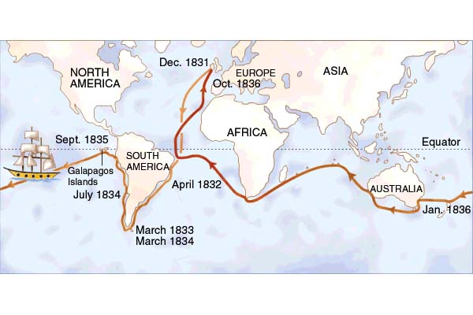
Darwin’s Voyage

Slide 10
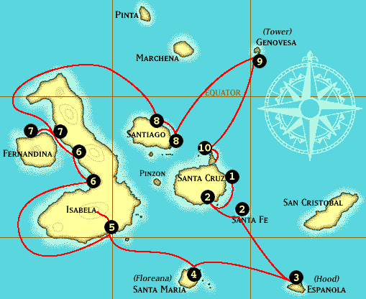
Galapagos Islands

Slide 11
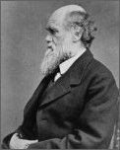
Core principles of evolution:
  All life is linked through a _____________
  populations of living things change with time (________________),
  the environment influences this change (_______________________) so that
  helpful traits are selected over less-helpful traits and the former become more common in the population (_____________).
Charles Darwin

Slide 12
Darwin’s Theory of Evolution by Natural Selection
All organisms vastly overproduce
There is variation within a population. Some variations are good (helpful)
Not all young produced in a generation can survive
  - This leads to a struggle for existence.
Those that survive and reproduce are those with the good variations.
  Survival of the fittest.

Slide 13


  Back in England, Malthus’ book on limits to population growth has strong impact (struggle for existence, preservation of good traits, loss of bad traits).
  C. Wallace’s letter outlining basic principles of natural selection spurs Darwin into taking his ideas public.

Slide 14

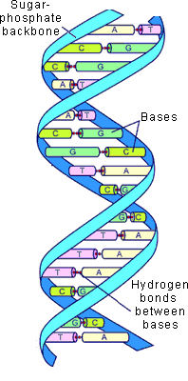
After much fierce debate, Darwin’s thesis that living beings evolve over time in response to natural forces is accepted among most scientists by about 15 years after publication of On the Origin of Species by Means of Natural Selection. “Means” of natural selection are debated into modern times.
Advances in genetics in the twentieth century
yield the mechanism through which natural selection operates, vindicating Darwin’s ideas.

Slide 15
V. Opposition to the Theory of Evolution
  A. Evolutionary theory, more than any other scientific theory, is regularly challenged.
  Much of the objection comes from a mistaken view of what a scientific theory represents.
  Evolution is the theory of how life changes
  Natural selection is the Process by which this occurs.

Slide 16
EVIDENCE For Evolution:
Fossils
Biogeography
Comparative Morphology
Comparative Embryology
Molecular Biology /Similarities in DNA
Experimentation
Observation

Slide 17
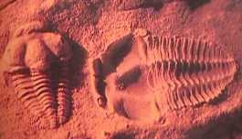
The Evidence for Evolution : 1. FOSSILS
A. the age of fossils found in sedimentary rocks can be determined using radioactive decay.
  B. Fossils of simpler organisms are found in older rocks, newer rocks contain more complex organisms

Slide 18
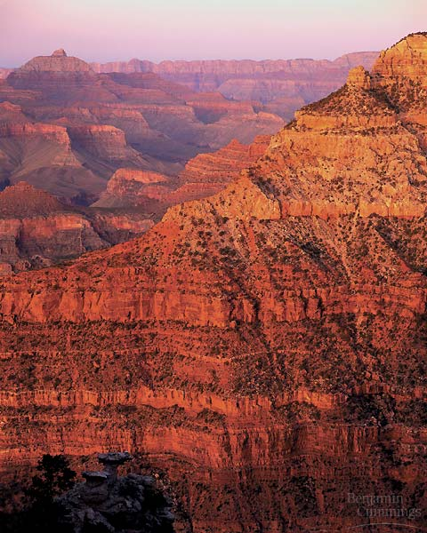
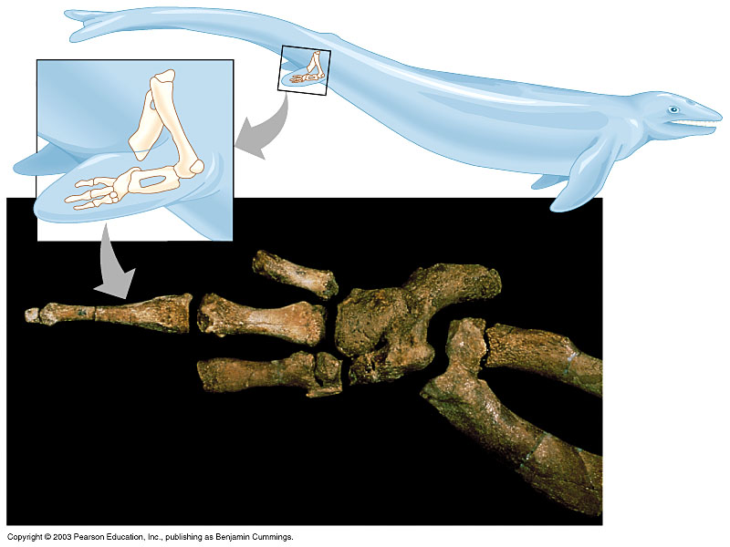
The fossil record shows that organisms have appeared in a historical sequence
Figure 13.2G, H

Slide 19
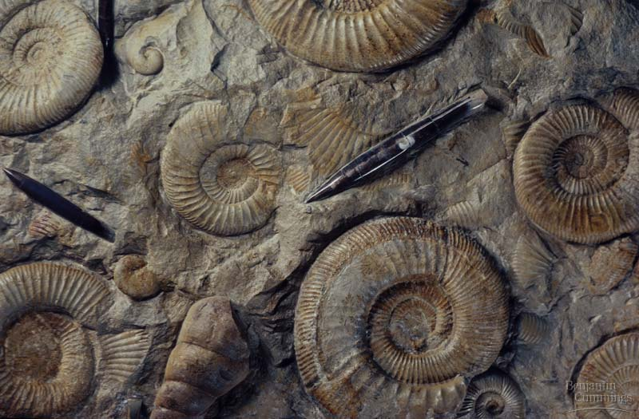
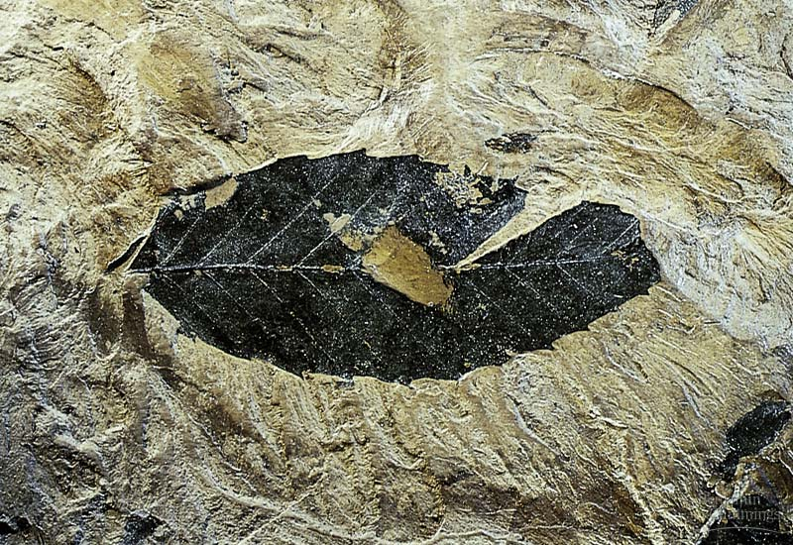
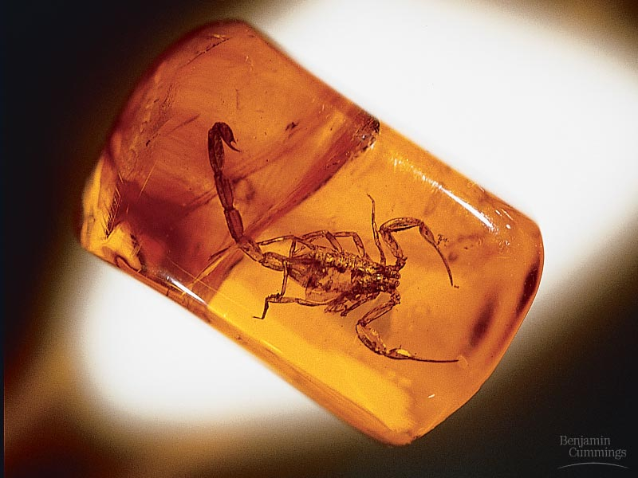
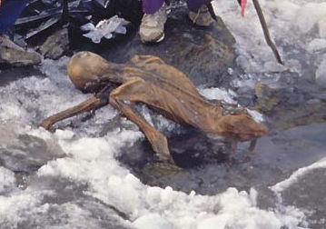
  Ammonite casts
  Fossilized organic matter in a leaf
  Scorpion in amber
  “Ice Man”

Slide 20
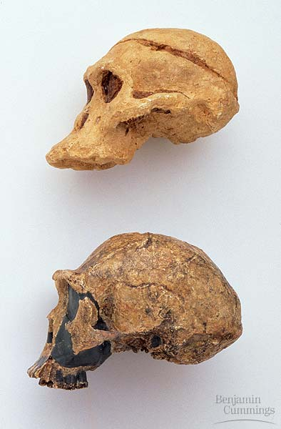
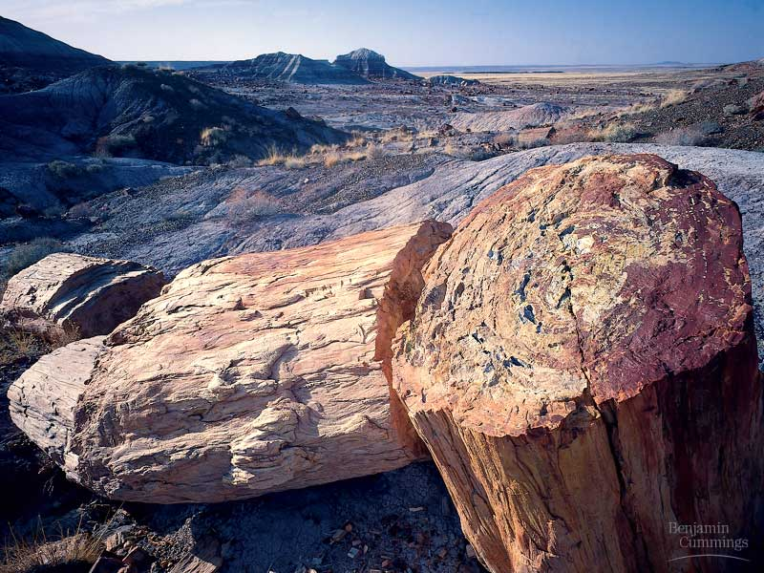
13.2 The study of fossils provides strong evidence for evolution
Fossils and the fossil record strongly support the theory of evolution
  Hominid skull
  Petrified trees
Figure 13.2A, B

Slide 21

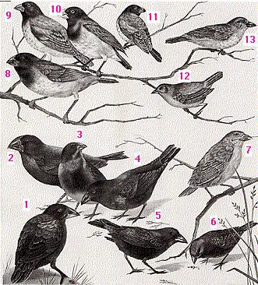
Biogeography = the distribution of living things
  While there is a striking correlation between form of finch species and the environment they inhabit;these species are also similar to a mainland species:
  The island species are derived from mainland species and have become different over time because of a change in the environment on the islands.
Darwin’s finches →

Slide 22
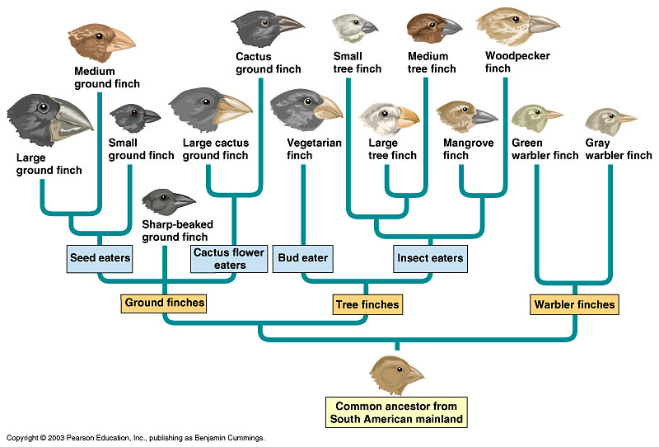
Darwin’s Finches

Slide 23
The Evidence for Evolution
Comparative Anatomy
Similarities in form and structure (morphology) between otherwise different-appearing structures, that is organization of bones in fins of whales, wings of bat, paws of cat and gorilla, point to their common evolutionary origin (homology);

Slide 24
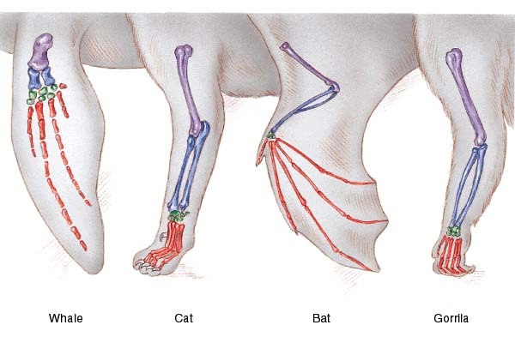
Homologous Structures – similar morphology, even if function is different, indicates a close evolutionary relationship

Slide 25
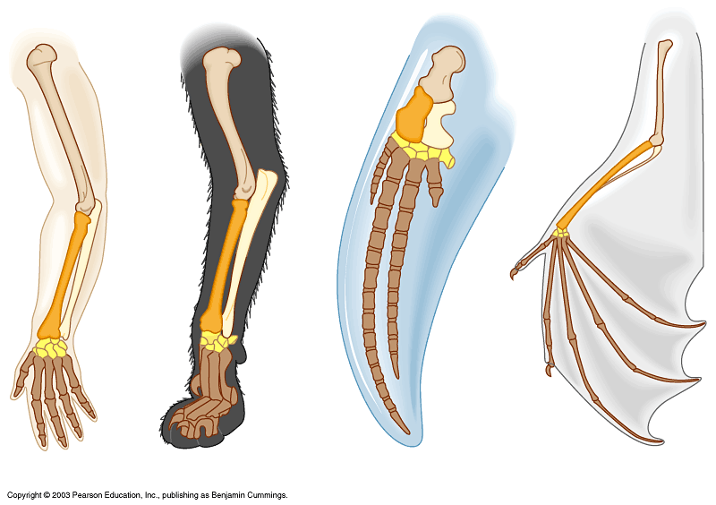
13.3 A mass of evidence validates the evolutionary view of life
Other evidence for evolution comes from
Human
Cat
Whale
Bat
Figure 13.3A

Slide 26
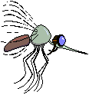
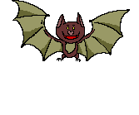

Analogous Structures – demonstrate organisms are not related evolutionarily – similar function, different morphology
BAT WING INSECT WINGS

Slide 27
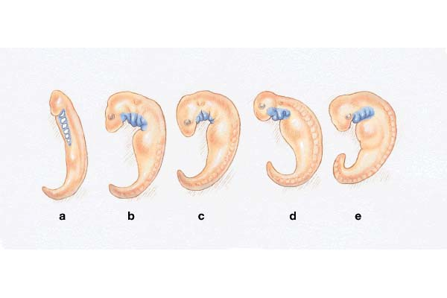
3. Comparative Embryology
sea lamprey turtle chicken cat human
Early embryo development in all animals goes through similar stages, (producing structures not seen in adults of the more complex organisms e.g., pharyngeal slits in humans).

Slide 28
4. Advances in Molecular Biology
Genetics showed that there were discrete particles of inheritance – genes
  AND revealed similarity in genes that control cellular function in very different organisms :
  The SAME set of genes controls many early events in the development of the fruit fly and mouse – HOX Genes
  it’s how these genes are used that makes the difference

Slide 29
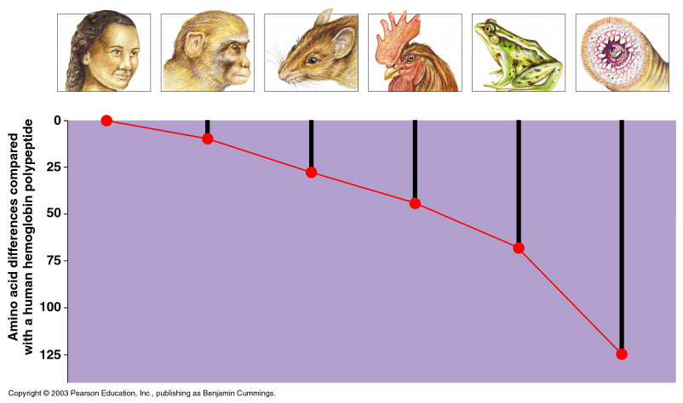
  Molecular biology
Human
Rhesus monkey
Mouse
Chicken
Frog
Lamprey
Last common
ancestor lived
26 million years
ago (MYA),
based on
fossil evidence
80 MYA
275 MYA
330 MYA
450 MYA
Figure 13.3B

Slide 30
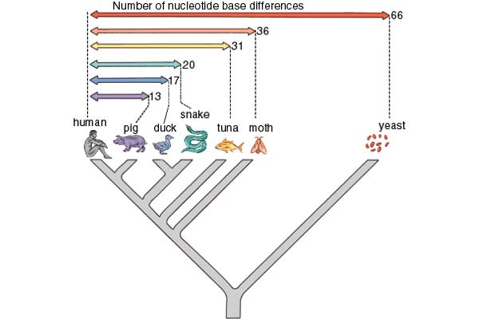
5. Similarities in DNA show how closely related organisms are to each other.

Slide 31
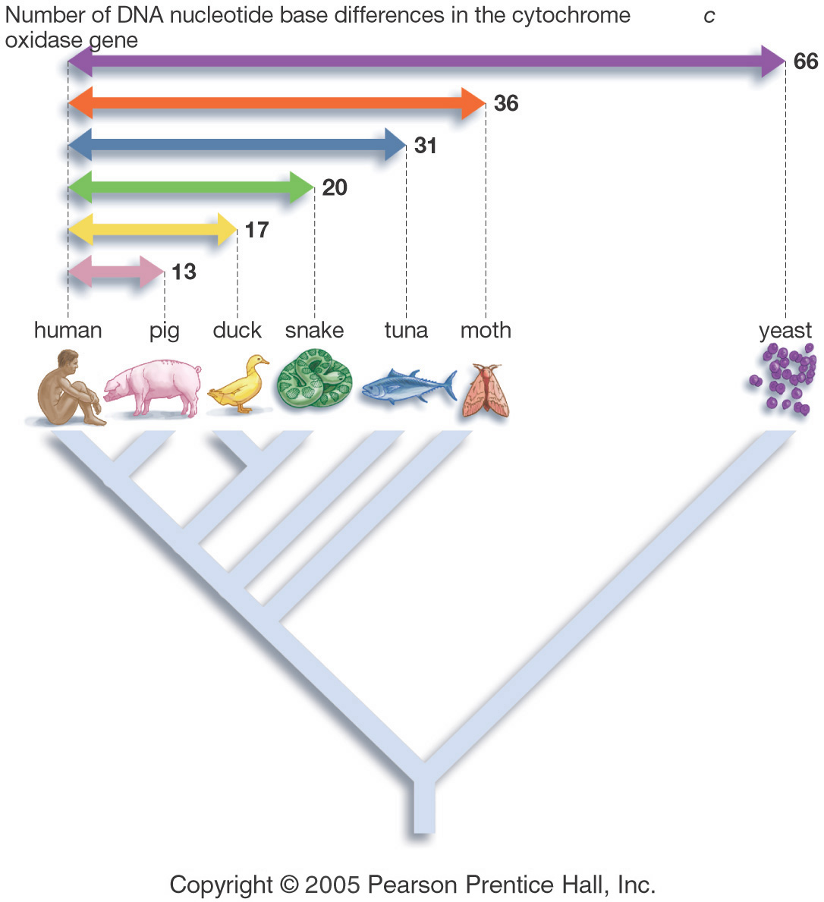
Evidence of Evolution –Conservation and Diversification at the Molecular Level - DNA
Why should different organism possess related genes?
Why does the degree of relationship of genes match their degree of relationship established by other methods?

Slide 32

Experimental evidence can demonstrate natural selection at work;
Endler’s experiments with guppies: In predator-free environments there’s an increase in number of male guppies with large and brightly colored tails, because they are favored by females; but when predators are reintroduced the number of male guppies with smaller, less conspicuous tails increases again because the flashier fish are eaten by predators.

Slide 33
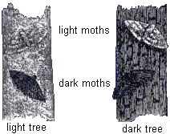
Evolution Observed: Peppered Moths
Less pollution
More pollution
Light moths
Dark moths
Light tree
Dark tree

Slide 34
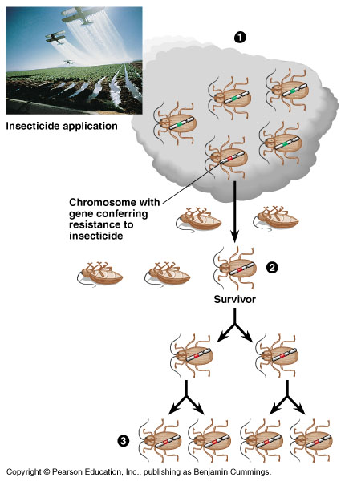
Evidence for Evolution – Evolution Observed
Evolution of pesticide resistance in response to selection.

Slide 35
Humans have Artificailly Selected organisms for a long time
Examples:
  Pigeons
  Horses
  Cows
  Corn
  Cereal plants
  Dogs

Slide 36
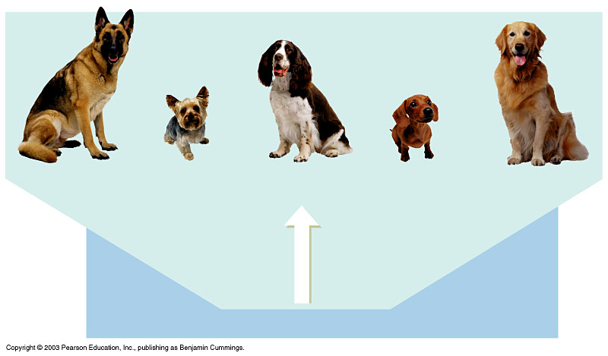
  Example of artificial selection in animals:
  dog breeding
German shepherd
Yorkshire terrier
English springer
spaniel
Mini-dachshund
Golden retriever
Hundreds to
thousands of years
of breeding
(artificial selection)
Ancestral dog
Figure 13.4B

Slide 37
What is a SPECIES?
Group of similar organisms
  Structurally:________________________
  Biochemically:______________________
Can interbreed successfully in nature
  Offspring are healthy
  Offspring are fertile (________________)

Slide 38
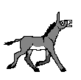

These organisms are not new species…Why?
Mule
Liger

Slide 39
Origin of Species
Speciation – evolution of one or more species from a single ancestor species. can be from:
  1. Isolation – reproductive or geographic -usually because of a geographic barrier such as a canyon, mountain, or island

Slide 40
2. Variation and Adaptation
Members of a species are very similar, but differences can be observed, making each individual unique. - Variation
Genetics explained how inherited variation occurred, how it was passed on from one generation to the next
Variation may be caused by mutations or hereditary recombination during meiosis.

Slide 41
a. Mutations
Changes in DNA base sequences
Most are either neutral or harmful
Those that allow the organism to survive better in a particular environment are good and are more likely to be passed on to future generations.

Slide 42
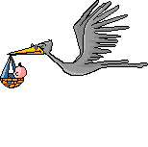
b. Most variations are not caused by mutations
Sexual reproduction combines genes from different parents
Crossing over during meiosis can produce variations

Slide 43
Adaptation
An inherited trait that increases the population’s chances of survival and reproduction in a particular environment.
Allows organisms to fit best into a particular niche (habitat and role)

Slide 44
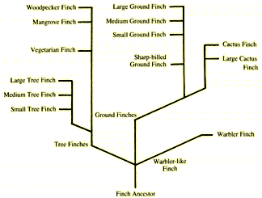
Adaptive Radiation
Many different species evolve from one ancestral species – each new species has a different niche

Slide 45
Biodiversity
The variety and abundance of species that makes up a biological community.
Pine Barrens forests have little biodiversity – a limited number of species can survive there.
Tropical rain forests have great biodiversity – many species in a concentrated area.

Slide 46
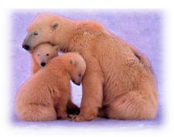
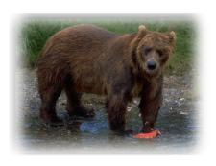
Divergent Evolution
Isolated populations of one species evolve independently of each other in response to different environments.
  Ex – polar bears and brown bears

Slide 47
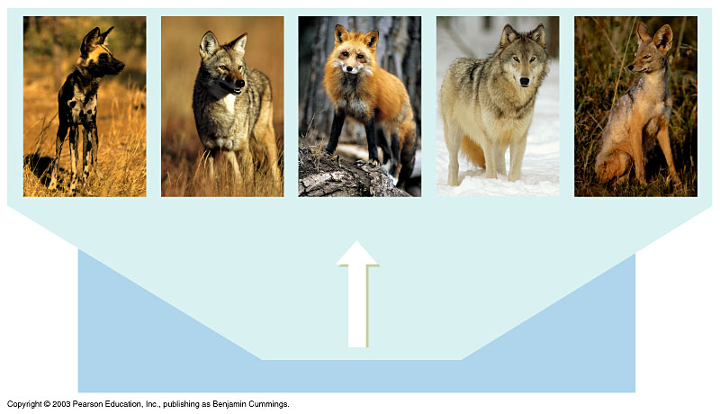
These five canine species evolved from a common ancestor through natural selection
African wild
dog
Coyote
Fox
Wolf
Jackal
Thousands to
millions of years
of natural selection
Ancestral canine
Figure 13.4C

Slide 48
Convergent Evolution
Natural Selection produces analagous (similar) adaptations in different organisms in response to similar environments:
  African Serval cat & south american maned wolf
      These animals have similar ears, legs, acute hearing, habitat, and Occupy similar niches

Slide 49
Coevolution
Species that interact closely often adapt to one another:

Slide 50
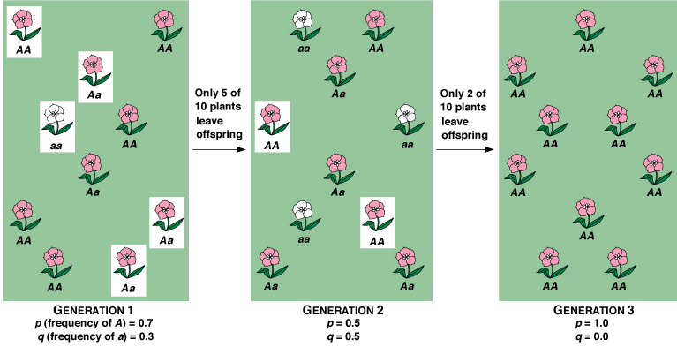
Evolutionary Time Scales
Microevolution: Short time scale events (generation-to-generation) that change the genotypes and phenotypes of populations.
We’ll begin our more intensive look at evolution with microevolution.

Slide 51
