Slide 1
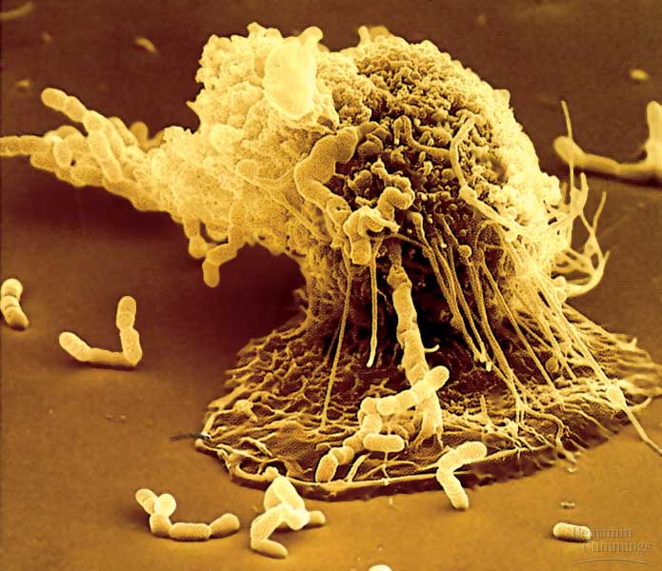

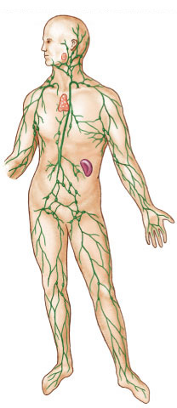
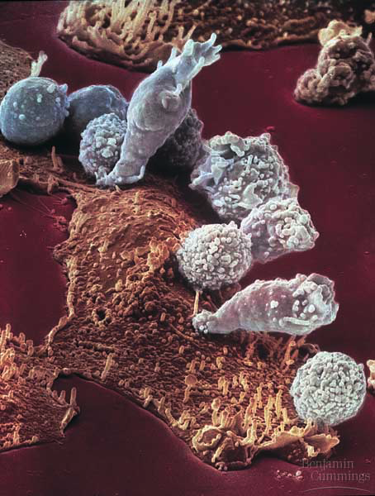
Fighting the
Enemy Within!
phagocytic leukocyte
Immune / Lymphatic
System
lymphocytes
attacking
cancer cell
lymph
system

Slide 2
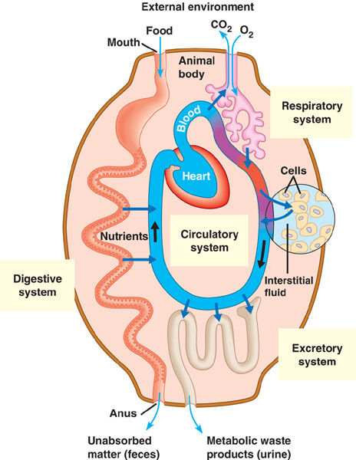
Avenues of attack
Points of entry
  digestive system
  respiratory system
  urogenital tract
  break in skin
Routes of attack
  circulatory system
  lymph system

Slide 3
Why an immune system?
Attack from outside
  lots of organisms want you for lunch!
  animals are a tasty nutrient- & vitamin-packed meal
    cells are packages of macromolecules
  animals must defend themselves against invaders (pathogens)
    viruses
      HIV, flu, cold, measles, chicken pox
    bacteria
      pneumonia, meningitis, tuberculosis
      Lyme disease
    fungi
      yeast (“Athlete’s foot”…)
    protists
      amoeba, malaria
Attack from inside
  cancers = abnormal body cells
Mmmmm,
What’s in your
lunchbox?

Slide 4
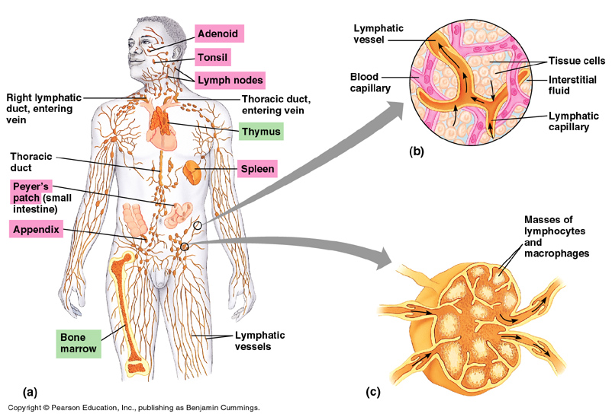
Lymph system
Production & transport of leukocytes
Traps foreign invaders
lymph vessels
(intertwined amongst blood vessels)
lymph node

Slide 5
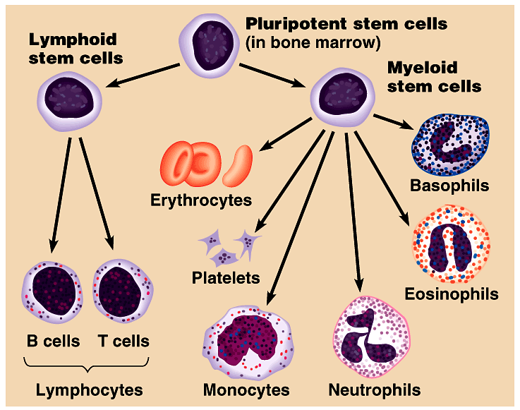
Development of Red & White blood cells
Red blood cells
inflammatory
response
fight
parasites
Leukocytes
Lymphocytes
develop into
macrophages
short-lived phagocytes
60-70% WBC

Slide 6
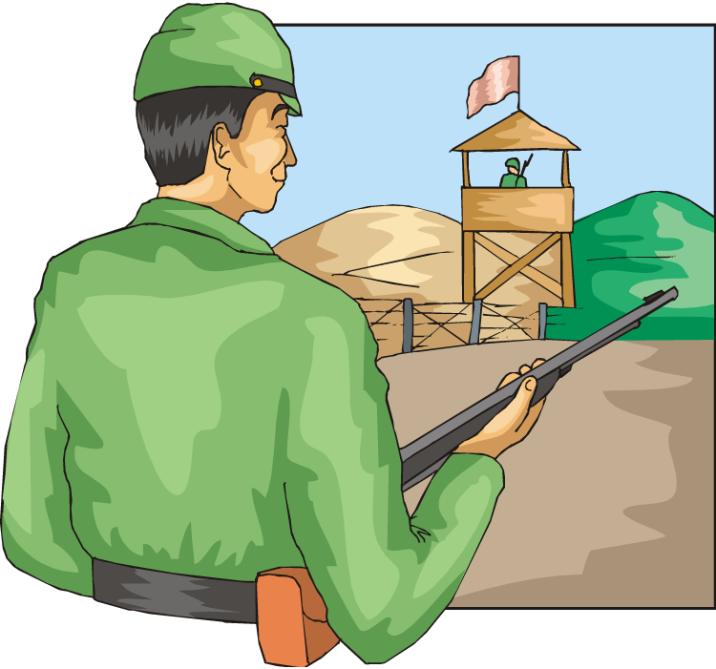
Lines of defense
1st line: Non-specific barriers
  broad, external defense
    “walls & moats”
  skin & mucous membranes
2nd line: Non-specific patrols
  broad, internal defense
    “patrolling soldiers”
  leukocytes = phagocytic WBC
3rd line: True immune system
  specific, acquired immunity
    “elite trained units”
  lymphocytes & antibodies
    B cells & T cells
Bacteria & insects
inherit resistance.
Vertebrates
acquire immunity.

Slide 7
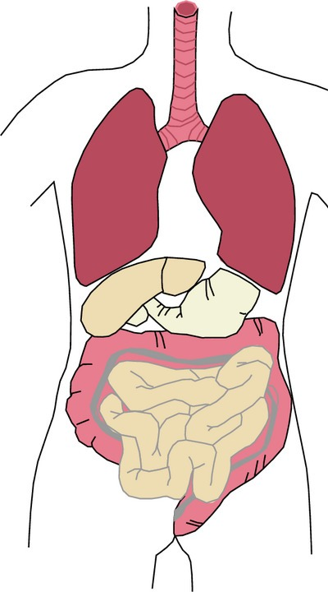
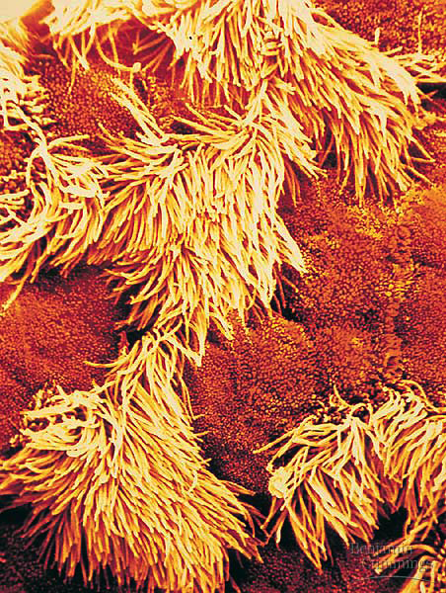
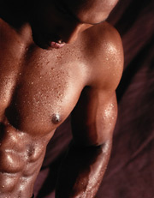
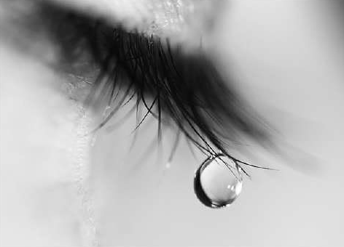
1st line: Non-specific External defense
Lining of trachea:
ciliated cells & mucus secreting cells
Barrier
    skin
Traps
    mucous membranes, cilia,
    hair, earwax
Elimination
    coughing, sneezing, urination, diarrhea
Unfavorable pH
    stomach acid, sweat, saliva, urine
Lysozyme enzyme
    digests bacterial cell walls
    tears, sweat

Slide 8
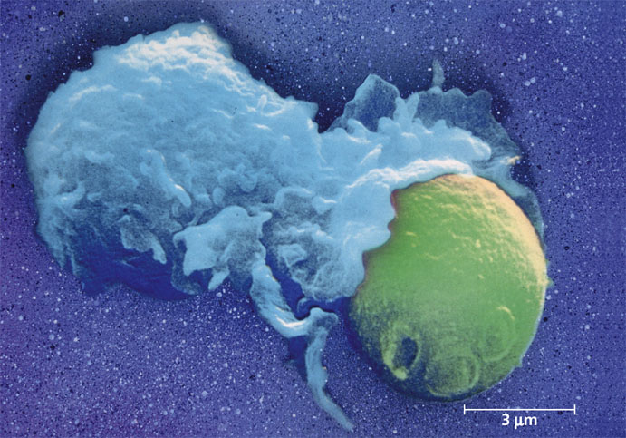
2nd line: Non-specific patrolling cells
Patrolling cells & proteins
  attack pathogens, but don’t “remember” for next time
    leukocytes
      phagocytic white blood cells
      macrophages, neutrophils, natural killer cells
    complement system
      proteins that destroy cells
    inflammatory response
      increase in body temp.
      increase capillary permeability
      attract macrophages
bacteria
macrophage
yeast

Slide 9
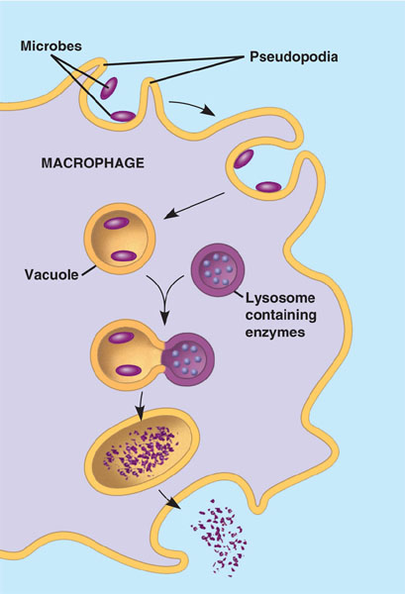
Leukocytes: Phagocytic WBCs
Attracted by chemical signals released by damaged cells
  ingest pathogens
  digest in lysosomes
Neutrophils
  most abundant WBC (~70%)
  ~ 3 day lifespan
Macrophages
  “big eater”, long-lived
Natural Killer Cells
  destroy virus-infected cells
  & cancer cells

Slide 10
Phagocytic WBC’s
Produced throughout life by the bone marrow.
Scavengers – remove dead cells and microorganisms.

Slide 11
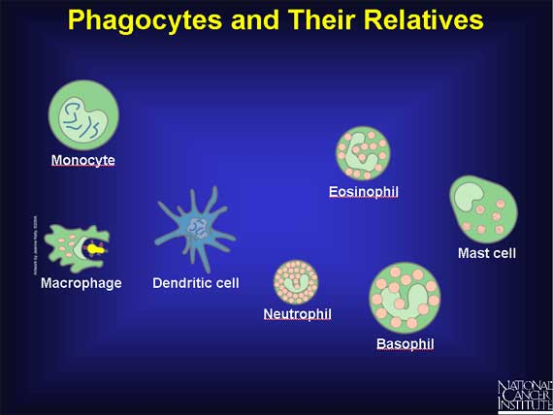

Slide 12
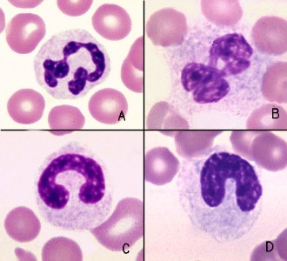
Neutrophils
60% of WBCs
‘Patrol tissues’ as they squeeze out of the capillaries.
Large numbers are released during infections
Short lived – die after digesting bacteria
Dead neutrophils make up a large proportion of pus.

Slide 13
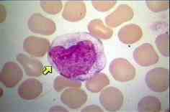
Macrophages
Larger than neutrophils.
Found in the organs, not the blood.
Made in bone marrow as monocytes, called macrophages once they reach organs.
Long lived
Initiate immune responses as they display antigens from the pathogens to the lymphocytes.

Slide 14
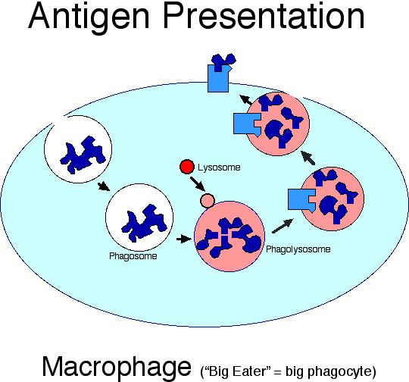
Macrophages

Slide 15
Phagocytosis
If cells are under attack they release histamine as part of immune response.
Histamine plus chemicals from pathogens mean neutrophils are attracted to the site of attack.
Pathogens are attached to antibodies and neutrophils have antibody receptors.
Enodcytosis of neutrophil membrane → phagocytic vacuole.
Lysosomes attach to phagocytic vacuole → pathogen digested by proteases

Slide 16
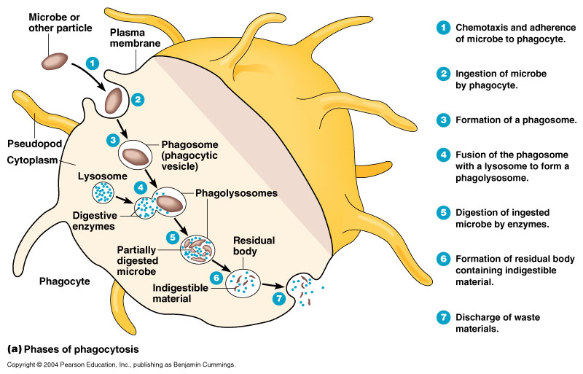
Phagocytosis

Slide 17
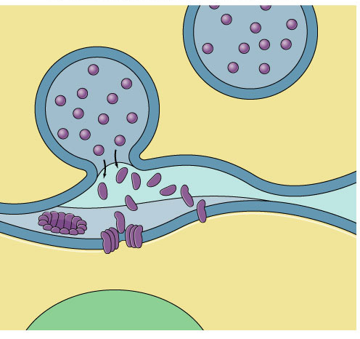
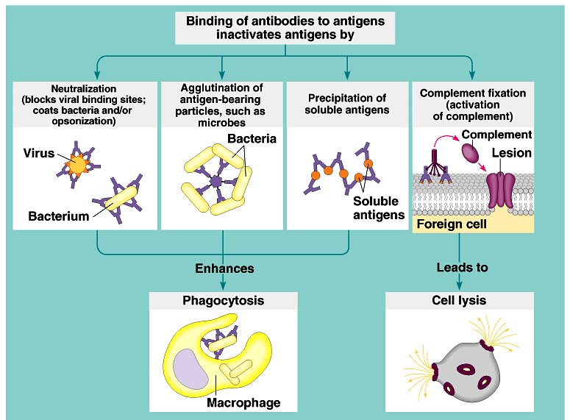
Destroying cells gone bad!
Natural Killer Cells perforate cells
  release perforin protein
  insert into membrane of target cell
  forms pore allowing fluid to
  flow in & out of cell
  cell ruptures (lysis)
    apoptosis
vesicle
natural killer cell
perforin
cell
membrane
perforin
punctures
cell membrane
cell
membrane
virus-infected cell

Slide 18
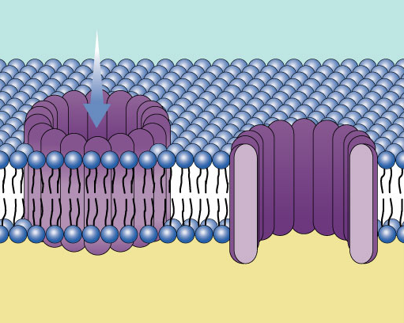
Anti-microbial proteins
Complement system
  ~20 proteins circulating in blood plasma
  attack bacterial & fungal cells
    form a membrane attack complex
    perforate target cell
    apoptosis
      cell lysis
extracellular fluid
complement proteins
form cellular lesion
plasma membrane of invading microbe
complement proteins
bacterial cell

Slide 19
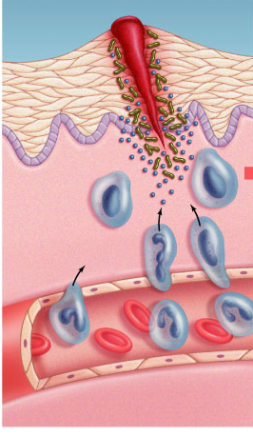
Inflammatory response
Damage to tissue triggers local non-specific inflammatory response
  release chemical signals
    histamines & prostaglandins
  capillaries dilate, become
  more permeable (leaky)
    delivers macrophages, RBCs, platelets, clotting factors
      fight pathogens
      clot formation
  increases temperature
    decrease bacterial growth
    stimulates phagocytosis
    speeds up repair of tissues

Slide 20
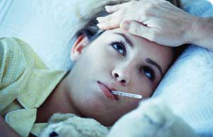
Fever
When a local response is not enough
  system-wide response to infection
  activated macrophages release interleukin-1
    triggers hypothalamus in brain to readjust body thermostat to raise body temperature
  higher temperature helps defense
    inhibits bacterial growth
    stimulates phagocytosis
    speeds up repair of tissues
    causes liver & spleen to store
    iron, reducing blood iron levels
      bacteria need large amounts
      of iron to grow
Notes:
Certain bacterial infections can induce an overwhelming systemic inflammatory response leading to a condition known as septic shock.
Characterized by high fever and low blood pressure, septic shock is the most common cause of death in U.S. critical care units.
Clearly, while local inflammation is an essential step toward healing, widespread inflammation can be devastating.

Slide 21
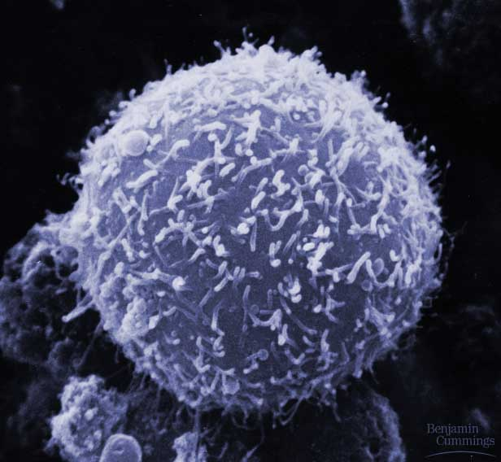
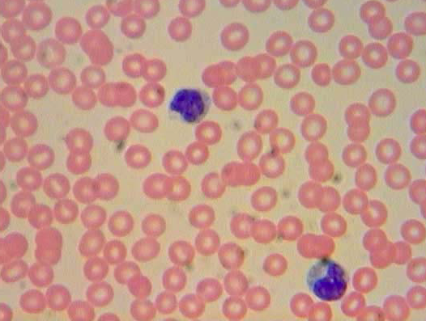
3rd line: Acquired (active) Immunity
Specific defense with memory
  lymphocytes
    B cells
    T cells
  antibodies
    =immunoglobulins
Responds to…
  antigens
    cellular name tags
      specific pathogens
      specific toxins
      abnormal body cells (cancer)
B cell

Slide 22
How are invaders recognized?
Antigens
  cellular name tag proteins
    “self” antigens
      no response from WBCs
    “foreign” antigens
      response from WBCs
      pathogens: viruses, bacteria, protozoa, parasitic worms, fungi, toxins
      non-pathogens: cancer cells, transplanted tissue, pollen
“self”
“foreign”

Slide 23
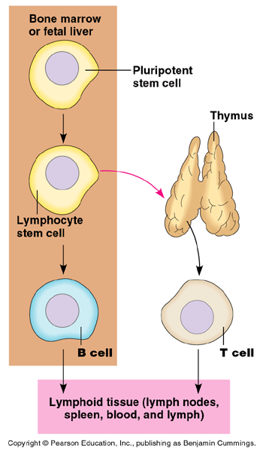
Lymphocytes
bone marrow
B cells
  mature in bone marrow
  humoral response system
    “humors” = body fluids
    attack pathogens still circulating
    in blood & lymph
  produce antibodies
T cells
  mature in thymus
  cellular response system
    attack invaded cells
“Maturation”
  learn to distinguish “self”
  from “non-self” antigens
    if react to “self” antigens, cells
    are destroyed during maturation
Notes:
Tens of millions of different T cells are produced, each one specializing in the recognition of oen particar antigen.

Slide 24
B cells
Attack, learn & remember pathogens circulating in blood & lymph
Produce specific antibodies
against specific antigen
Types of B cells
  plasma cells
    immediate production of antibodies
    rapid response, short term release
  memory cells
    continued circulation in body
    long term immunity

Slide 25
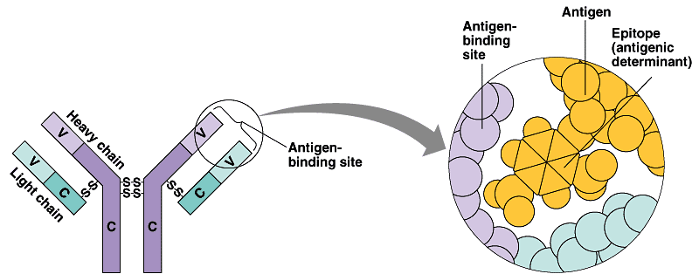
Antibodies
Y
Y
Y
Y
Y
Y
Y
Y
Y
Y
Y
Y
Y
Y
Y
Y
Y
Y
Y
Y
Y
Y
Y
Y
Y
Y
Proteins that bind to a specific antigen
  multi-chain proteins
  binding region matches molecular shape of antigens
  each antibody is unique & specific
    millions of antibodies respond to millions of
    foreign antigens
  tagging “handcuffs”
    “this is foreign…gotcha!”
Y
Y
Y
Y
Y
Y
Y
Y
Y
Y
Y
Y
Y
Y
Y
antigen-
binding site on antibody
antigen
Y
Y
Y
Y
variable
binding region
Y
Y
each B cell
has ~50,000
antibodies

Slide 26
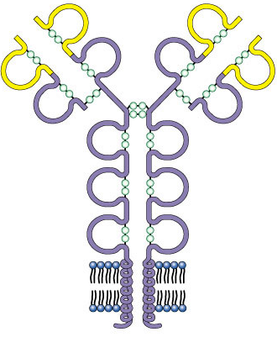
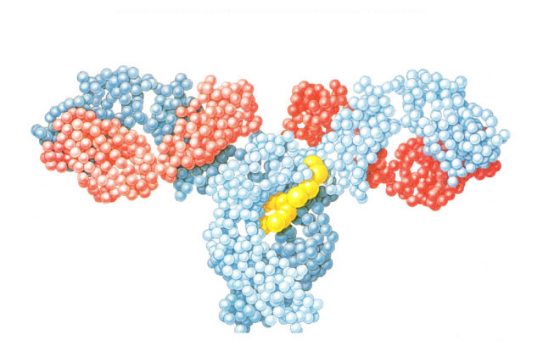
Structure of antibodies
Y
Y
Y
Y
Y
Y
Y
Y
Y
antigen-binding site
Y
Y
Y
s
s
variable region
Y
Y
Y
s
s
Y
Y
s
s
s
s
Y
Y
Y
Y
s
s
s
s
Y
s
s
Y
Y
s
s
s
s
s
s
Y
light
chain
s
s
light
chain
s
s
s
s
s
s
heavy
chains
s
s
light chains
s
s
s
s
s
s
B cell
membrane
antigen-binding
site
antigen-binding
site
heavy chains

Slide 27
What do antibodies do to invaders?
neutralize
capture
precipitate
apoptosis
invading pathogens tagged with antibodies
Y
Y
Y
Y
Y
Y
macrophage
eating tagged invaders
Notes:
Antibody opsonization…Is the process by which a pathogen is marked for ingestion and destruction by a phagocyte.

Slide 28
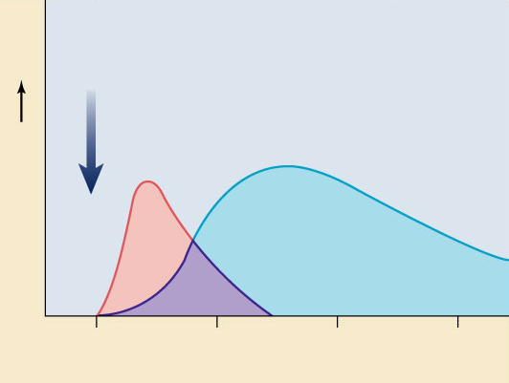
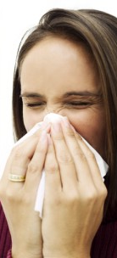
Classes of antibodies
invading pathogens tagged with antibodies
Exposure
to
antigen
IgM
Y
IgG
macrophage
eating tagged invaders
Immunoglobulins
  IgM
    1st immune response
    activate complement proteins
  IgG
    2nd response, major antibody circulating in plasma
    promote phagocytosis by macrophages
  IgA
    in external secretions, sweat & mother’s milk
  IgE
    promote release of histamine & lots of bodily fluids
    evolved as reaction to parasites
    triggers allergic reaction
  IgD
    receptors of B cells???
Y
Y
Antibody levels
Y
Y
Y
0
2
4
6
Weeks

Slide 29
B cell immune response
10 to 17 days for full response
Y
Y
Y
Y
Y
Y
Y
Y
Y
Y
tested by
B cells
(in blood & lymph)
Y
Y
Y
Y
Y
Y
Y
Y
Y
Y
Y
Y
Y
Y
Y
Y
Y
Y
Y
Y
Y
invader
(foreign antigen)
Y
Y
Y
Y
Y
Y
Y
Y
Y
Y
B cells + antibodies
Y
Y
Y
memory cells
“reserves”
Y
Y
Y
Y
Y
Y
Y
Y
Y
Y
Y
Y
Y
Y
Y
Y
Y
Y
Y
Y
Y
recognition
captured
invaders
Y
Y
Y
Y
Y
Y
Y
Y
Y
Y
Y
Y
Y
Y
Y
Y
Y
Y
Y
Y
Y
Y
Y
Y
Y
Y
Y
Y
Y
Y
Y
Y
Y
Y
Y
Y
Y
Y
Y
Y
Y
Y
Y
Y
Y
Y
macrophage
Y
Y
Y
Y
Y
Y
Y
Y
Y
Y
Y
Y
Y
Y
Y
Y
Y
Y
Y
Y
Y
Y
Y
Y
Y
Y
Y
Y
Y
Y
Y
Y
Y
Y
Y
Y
Y
Y
Y
clones
1000s of clone cells
Y
Y
plasma cells
release antibodies
Y
Y
Y
Y
Y
Y
Y
Y
Y
Y
Y
Y

Slide 30
Animation:
Animation Immune response - Mcgraw Hill

Slide 31
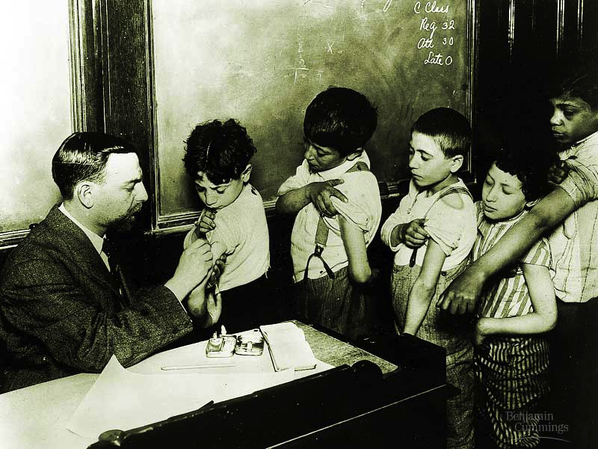
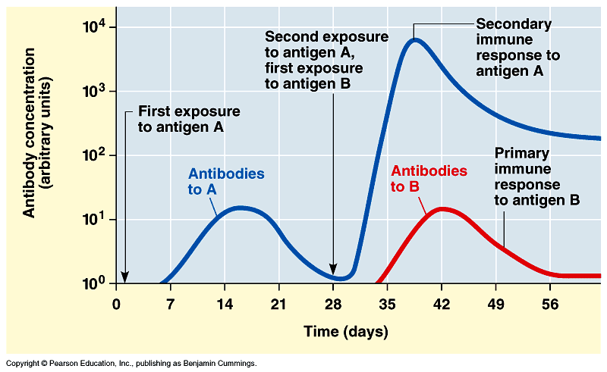
Vaccinations
Immune system exposed
to harmless version of pathogen
  stimulates B cell system to produce
  antibodies to pathogen
    “active immunity”
  rapid response on future exposure
  creates immunity
  without getting
  disease!
Most successful
against viruses

Slide 33
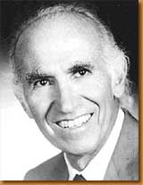
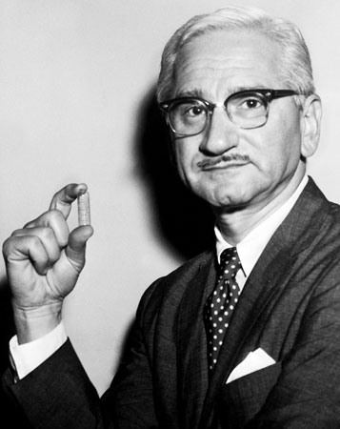
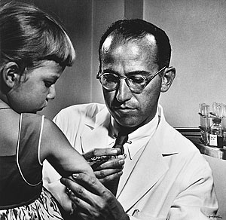
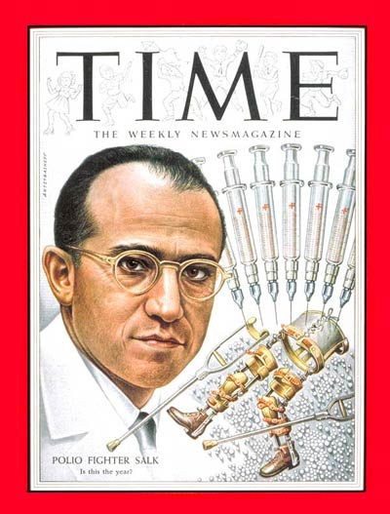
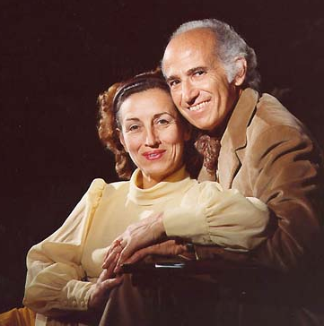
Jonas Salk
1914 – 1995
April 12, 1955
Developed first vaccine
  against polio
    attacks motor neurons
Albert Sabin
1962
oral vaccine
Notes:
Poliomyelitis (polio) is caused by a virus that enters the body through the mouth. The virus multiplies in the intestine and invades the nervous system. It can cause total paralysis in a matter of hours.
One in 200 infections leads to irreversible paralysis. Among those paralyzed, 5-10 percent die when their breathing muscles are immobilized.
Polio mainly affects children under age 5.
Salk vaccine = inactivated poliovirus vaccine (IPV), based on poliovirus grown in a type of monkey kidney tissue culture, which is chemically inactivated with formalin
Sabin vaccine = oral polio vaccine (OPV) using live but weakened (attenuated) virus, produced by the repeated passage of the virus through non-human cells at sub-physiological temperatures

Slide 34
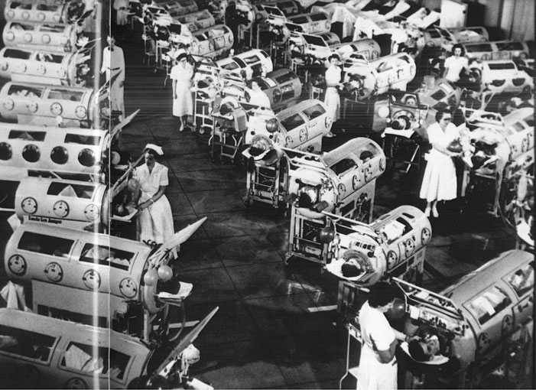
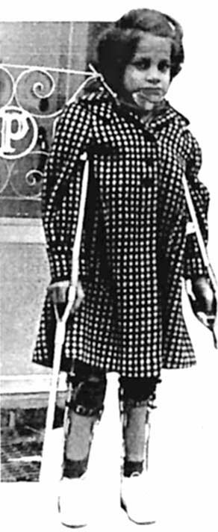
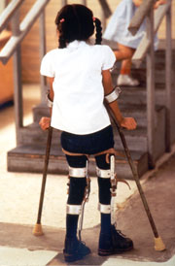
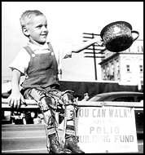
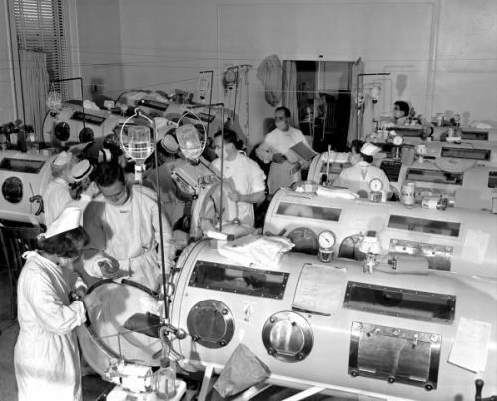
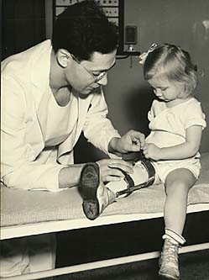
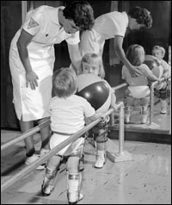
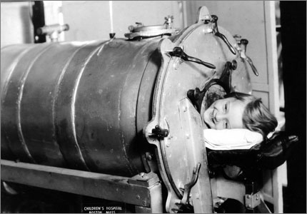
Polio epidemics
1994:
Americas polio free
Notes:
1916 The first major polio epidemic strikes in the United States; 27,000 people suffer paralysis and 6,000 die. Increasing numbers of outbreaks occur each year.
1921 Franklin D. Roosevelt is diagnosed with polio.
1928 Iron lungs are introduced to help patients with acute polio breathe.
1932 Franklin D. Roosevelt is elected President of the United States
1949 Dr. John Enders, Dr. Frederick Robbins and Dr. Thomas Weller develop a way to grow poliovirus in tissue culture, a breakthrough that aided in the creation of the polio vaccine. Their work earned the three scientists the Nobel Prize in physiology and medicine in 1954.
1952 The United States reports 57,628 polio cases -- the worst U.S. epidemic on record.
1979 The last U.S. case of polio caused by wild poliovirus is reported.
1988 Worldwide, polio continues to affect some 350,000 people in 125 countries.
1994 The Americas are certified polio-free.
2000 The Western Pacific region is certified polio-free.
2002 Europe is certified polio-free.

Slide 35

Passive immunity
Obtaining antibodies from another individual
  maternal immunity
    antibodies pass from mother to baby across placenta or in mother’s milk
    critical role of breastfeeding in infant health
      mother is creating antibodies against pathogens baby is being exposed to
Injection
  injection of antibodies
  short-term immunity

Slide 36
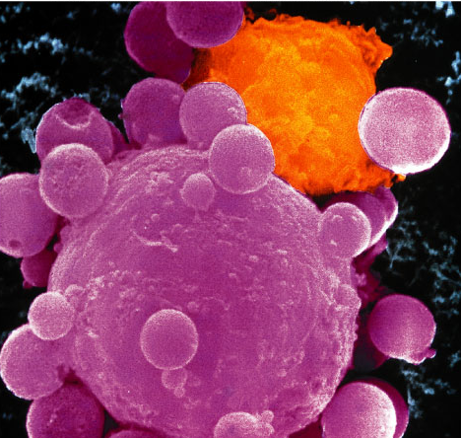
What if the attacker gets past the B cells in the blood & actually infects (hides in) some of your cells?
You need trained assassins to recognize & kill off these infected cells!
Attack
of the
Killer T cells!
T
But how do T cells
know someone is
hiding in there?

Slide 37
How is any cell tagged with antigens?
Major histocompatibility (MHC) proteins
  proteins which constantly carry bits of cellular material from the cytosol to the cell surface
  “snapshot” of what is going on inside cell
  give the surface of cells a unique label or “fingerprint”
MHC protein
Who goes there?
self or foreign?
T or B
cell
MHC proteins
displaying self-antigens

Slide 38
How do T cells know a cell is infected?
Infected cells digest some pathogens
  MHC proteins carry pieces to cell surface
    foreign antigens now on cell membrane
    called Antigen Presenting Cell (APC)
      macrophages can also serve as APC
    tested by Helper T cells
infected
cell
MHC proteins displaying
foreign antigens
WANTED
T_{H} cell
T cell with antigen receptors

Slide 39
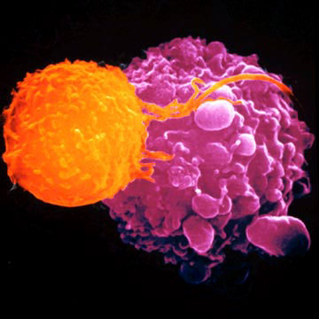
T cells
Attack, learn & remember pathogens hiding in infected cells
  recognize antigen fragments
  also defend against “non-self” body cells
    cancer & transplant cells
Types of T cells
  helper T cells
    alerts rest of immune system
  killer (cytotoxic) T cells
    attack infected body cells
  memory T cells
    long term immunity
T cell attacking cancer cell

Slide 40
T cell response
APC:
infected cell
killer
T cell
recognition
helper
T cell
interleukin 2
activate
killer T cells
helper
T cell
interleukin 1
helper
T cell
stimulate
B cells &
antibodies
or
APC:
activated
macrophage
helper
T cell
interleukin 2
Y
Y
Y
clones
Y
Y
Y
Y
Y
Y
helper
T cell
Y
Y
Y
Y
Y
Y
Y
Y
Y
Y
Y
Y
Y
Y
Y
recognition
Y
Y
Y
Y
Y
Y
Y
Y
Y
Y
Y
Y
Y
Y
Y
Y

Slide 41
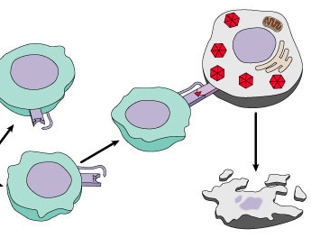
Attack of the Killer T cells
Destroys infected body cells
  binds to target cell
  secretes perforin protein
    punctures cell membrane of infected cell
      apoptosis
vesicle
Killer T cell
Killer T cell
binds to
infected cell
cell
membrane
perforin
punctures
cell membrane
cell
membrane
infected cell
destroyed
target cell

Slide 42
Immune system & Blood type
blood type | antigen on RBC | antibodies in blood | donationstatus
A | type A antigens on surface of RBC | anti-B antibodies | __
B | type B antigens on surface of RBC | anti-A antibodies | __
AB | both type A & type B antigens on surface of RBC | no antibodies | universal recipient
O | no antigens on surface of RBC | anti-A & anti-B antibodies | universal donor
Matching compatible blood groups is critical for blood transfusions
A person produces antibodies against foreign blood antigens

Slide 43
Immune response
skin
pathogen invasion
antigen exposure
skin
free antigens in blood
antigens on infected cells
humoral response
macrophages
(APC)
cellular response
B cells
alert
helper
T cells
alert
T cells
plasma
B cells
memory
B cells
memory
T cells
cytotoxic
T cells
Y
Y
Y
Y
Y
Y
Y
Y
Y
Y
Y
antibodies
Y
Y
antibodies
Y
Y
Y
Y
Y
Y
Y
Y
Y

Slide 44
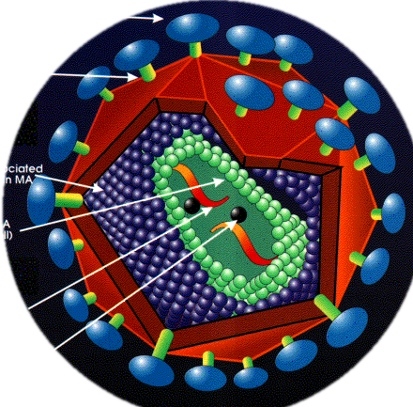

HIV & AIDS
Human Immunodeficiency Virus
  virus infects helper T cells
    helper T cells then won’t activate rest of immune system: killer T cells & B cells
    also destroys helper T cells
AIDS: Acquired ImmunoDeficiency Syndrome
  infections by opportunistic
  diseases
  death usually from
  “opportunistic” infections
    pneumonia, cancers
HIV infected T cell

Slide 45




How to protect yourself…

Slide 46
Immune system malfunctions
Auto-immune diseases
  immune system attacks own molecules & cells
    lupus
      antibodies against many molecules released by normal breakdown of cells
    rheumatoid arthritis
      antibodies causing damage to cartilage & bone
    diabetes
      beta-islet cells of pancreas attacked & destroyed
    multiple sclerosis
      T cells attack myelin sheath of brain & spinal cord nerves
Allergies
  over-reaction to environmental antigens
    allergens = proteins on pollen, dust mites, in animal saliva
    stimulates release of histamine

Slide 47
It’s safe
to Ask Questions!

