Slide 1
Understanding Infectious Disease
The term: "disease" refers to conditions that impair normal tissue function
Examples: cystic fibrosis, atherosclerosis, and measles…However, there are fundamentally different causes for each
CF – genetic
Atherosclerosis – aging/diet
Measles - infectious
Notes:
Cystic fibrosis (CF) is due to a specific genotype that results in impaired transport of chloride ions across cell membranes, leading to the production of abnormally thick mucus. Thus, CF is most accurately called a genetic or metabolic disease. Atherosclerosis, which can lead to heart attacks and strokes, may be considered a disease of aging, because it typically becomes a problem later in life after plaques of cholesterol have built up and partially blocked arteries. In contrast, measles is an infectious disease because it occurs when an individual contracts an outside agent, the measles virus.

Slide 2
Pathogens:
microorganisms that are capable of causing disease
most microorganisms do not cause disease
many probably provide some protection against harmful microorganisms because they effectively compete with the harmful organisms
Notes:
A true pathogen is an infectious agent that causes disease in virtually any susceptible host. Opportunistic pathogens are potentially infectious agents that rarely cause disease in individuals with healthy immune systems. Diseases caused by opportunistic pathogens typically are found among groups such as the elderly (whose immune systems are failing), cancer patients receiving chemotherapy (which adversely affects the immune system), or people who have AIDS or are HIV-positive. An important clue to understanding the effect of HIV on the immune system was the observation of a rare type of pneumonia among young men caused by Pneumocystis carinii, an organism that causes disease only among the immunosuppressed.

Slide 3
The terms "infection" and "disease" are not synonymous.
An infection results when a pathogen invades and begins growing within a host.
Disease results only if and when, as a consequence of the invasion and growth of a pathogen, tissue function is impaired.
Our bodies have defense mechanisms to prevent infection however, sometimes those mechanisms fail and disease results.
Notes:
Some pathogens then multiply between host cells or within body fluids, while others such as viruses and some bacterial species enter the host cells and grow there. Although the growth of pathogens may be enough to cause tissue damage in some cases, damage is usually due to the production of toxins or destructive enzymes by the pathogen. For example, Corynebacterium diphtheriae, the bacterium that causes diphtheria, grows only on nasal and throat surfaces. However, the toxin it produces is distributed to other tissues by the circulatory system, damaging heart, liver, and nerve tissues. Streptococcus pyogenes, the infectious agent associated with several diseases including strep throat and "flesh-eating disease," produces several enzymes that break down barriers between epithelial cells and remove fibrin clots, helping the bacteria invade tissues.

Slide 4
An Infectious Disease …
is a disease that is caused by the invasion of a host by pathogenic agents whose activities harm the host's tissues (that is, they cause disease) and can be transmitted to other individuals (that is, they are infectious).

Slide 5
Contagious vs Virulent Infections
Some infectious agents are easily transmitted (Contagious)but they are not very likely to cause disease (Virulent).
Ex: Polio virus - It probably infects most people who contact it, but only about 5 to 10 percent those infected actually develop clinical disease.
Other infectious agents are very virulent, but not terribly contagious.
The terror surrounding Ebola hemorrhagic fever is based on the virulence of the virus (50 to 90 percent fatality rate among those infected); however, the virus itself is not transmitted easily by casual contact.

Slide 6
The most worrisome infectious agents are those that are both very contagious and very virulent.

Slide 7
In order to cause disease, pathogens must be able to enter the host body
They must adhere to specific host cells, invade and colonize host tissues, and inflict damage on those tissues.
Some do damage at their point of entry, others travel to other parts of the host
Some reside and grow in body fluids like blood or lymph, between cells of body tissues or inside body cells.
Notes:
Some pathogens then multiply between host cells or within body fluids, while others such as viruses and some bacterial species enter the host cells and grow there. Although the growth of pathogens may be enough to cause tissue damage in some cases, damage is usually due to the production of toxins or destructive enzymes by the pathogen. For example, Corynebacterium diphtheriae, the bacterium that causes diphtheria, grows only on nasal and throat surfaces. However, the toxin it produces is distributed to other tissues by the circulatory system, damaging heart, liver, and nerve tissues. Streptococcus pyogenes, the infectious agent associated with several diseases including strep throat and "flesh-eating disease," produces several enzymes that break down barriers between epithelial cells and remove fibrin clots, helping the bacteria invade tissues.

Slide 8
Microbes That Cause Infectious Diseases
There are 4 major types of infectious agents:
bacteria
viruses
fungi
Parasites:
protozoa,
helminths
In addition, two new classes of infectious agents, the prions and viroids, have recently been recognized.

Slide 9
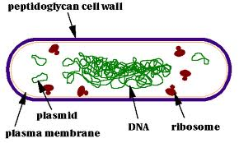
Bacteria
Bacteria are unicellular prokaryotic organisms with no organized internal membranous structures Their genomes are circular, double-stranded DNA.
Notes:
Some bacteria are photosynthetic and obtain their energy directly from the sun. Others oxidize inorganic compounds to supply their energy needs. Still other bacteria generate energy by breaking down organic compounds such as amino acids and sugars in a respiratory process. Some bacteria require oxygen (aerobes), while others are unable to tolerate it (anaerobes). Some bacteria can grow either with or without oxygen (facultative anaerobes).

Slide 10
Bacteria come in many shapes
three of the most common are
bacillus (rodshaped)
coccus (spherical)
spirillum (helical rods)

Slide 11
Gram Staining
Bacteria are divided into two broad classes based on their cell wall structures, which influences their Gram stain reaction.
Gram-negative bacteria appear pink after the staining procedure.
pathogenic gram-negative organisms are Salmonella typhi, which causes typhoid fever, and Yersinia pestis, which causes plague.
Gram-positive bacteria appear purple after the Gram stain procedure.
pathogenic gram-positive bacteria are Staphylococcus aureus, which causes skin, respiratory, and wound infections, and Clostridium tetani, which produces a toxin that can be lethal for humans.

Slide 12
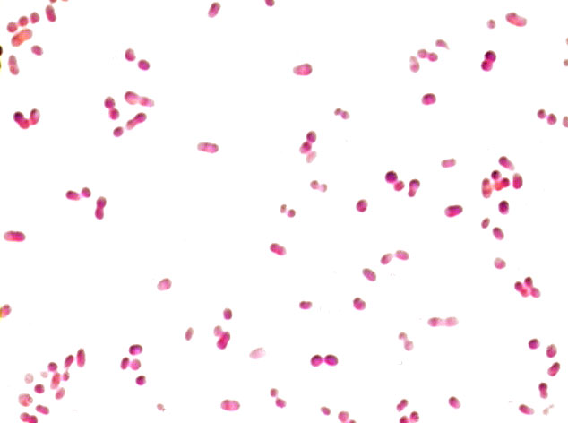
Gram negative
Gram positive

Slide 13
Viruses
Microbiologists have found viruses that infect all organisms, from plants and animals to fungi and bacteria.
Viruses, however, are not true organisms themselves
they have no metabolism and cannot reproduce.
A virus particle is composed of a viral genome of nucleic acid (DNA or RNA)_that is surrounded by a protein coat
viruses cause disease by disrupting normal cell function. They do this in a variety of ways.
Notes:
Some viruses make repressor proteins that stop the synthesis of the host cell's proteins, RNA, and DNA. Viral activity may weaken cell membranes and lysosomal membranes, leading to cell autolysis. Some viral proteins are toxic to cells, and the body's immune defenses also may kill virus-infected cells.

Slide 14
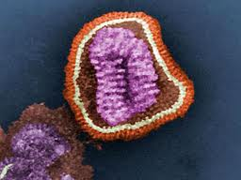
Adenovirus Influenza virus
Causes colds Causes the flu
Photographer: Sebastian Kaulitzki | Agency: Dreamstime.com
foxnews.com

Slide 15
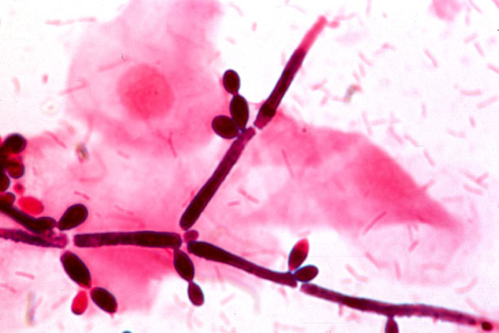
Fungi
Fungi are eukaryotic, heterotrophic organisms
-have rigid cellulose- or chitin-based cell walls
-reproduce primarily by forming spores.
Most fungi are multicellular, although some, such as yeasts, are unicellular.
Together with bacteria, fungi fulfill the indispensable role of decomposers in the environment.
Notes:
Antibiotics reduce the bacterial population normally present in the throat and vagina, allowing the yeast to grow unchecked.

Slide 16
Fungi - examples
Examples of diseases caused by fungi are:
Ringworm
Histoplasmosis (a mild to severe lung infection transmitted by bat or bird droppings).
Yeasts of the Candida genus are opportunistic pathogens that may cause diseases such as vaginal yeast infections and thrush (a throat infection) among people who are immunocompromised or undergoing antibiotic therapy.

Slide 17
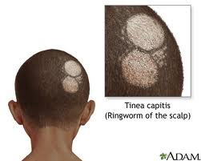
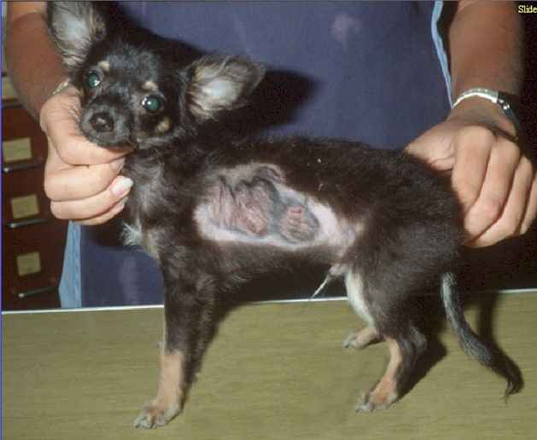
RINGWORM is not a worm!

Slide 18
Protozoa
Protozoa are unicellular, heterotrophic eukaryotes that include the familiar Amoeba and Paramecium.
No cell walls: as a result… they are capable of a variety of rapid and flexible movements.
Protozoa can be acquired through contaminated food or water or by the bite of an infected arthropod such as a mosquito.

Slide 19
Protozoa - Examples:
Diarrheal disease in the United States can be caused by two common protozoan parasites, Giardia lamblia and Cryptosporidium parvum.
Malaria, a tropical illness that causes 300 million to 500 million cases of disease annually, is caused by several species of the protozoan Plasmodium.
Notes:
Examples include Entamoeba histolytica, Plasmodium (some of which cause malaria), and Giardia lamblia.^{[2]} Trypanosoma brucei, transmitted by the tsetse fly and the cause of African sleeping sickness

Slide 20
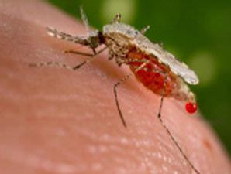
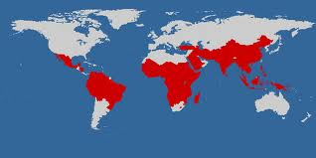
Malaria protozoan carried by mosquito host

Slide 21
Helminths
simple, invertebrate animals, some of which are infectious parasites.
They are multicellular and have differentiated tissues.
Because they are animals, their physiology is similar in some ways to ours. This makes parasitic helminth infections difficult to treat because drugs that kill helminths are frequently very toxic to human cells.

Slide 22
Hookworm attached to intestinal wall

Slide 23
Cutaneous larval migrans
results when roundworms that normally infect dogs or cats infect a human instead. The roundworm cannot develop normally because it is in the wrong host. Thus it wanders around under the skin.

Slide 24
Pathogens may reproduce Inside or Outside cells
Facultative
Facultative intracellular parasites are capable of living and reproducing either inside or outside cells.
Bacterial examples include Francisella tularensis and Listeria monocytogenes. Other examples include Brucella, Legionella, Mycobacterium, and Yersinia. The gram negative bacterium Neisseria meningitidis can reproduce intracellularly but is not obligate.^{[1]}
A fungal example is Histoplasma capsulatum.^{[2]}
Obligate
Obligate intracellular parasites cannot reproduce outside their host cell, meaning that the parasite's reproduction is entirely reliant on intracellular resources.
Obligate intracellular parasites of humans include:
Viruses
Certain bacteria, including:
Chlamydia, and closely related species.^{[3]}
Rickettsia
Coxiella
Certain species of Mycobacterium such as Mycobacterium leprae
Certain protozoa, including:
Plasmodia species
Leishmania spp.
Toxoplasma gondii
Trypanosoma cruzi
Notes:
The mitochondria in eukaryotic cells may also have originally been such parasites, but ended up forming a mutualistic relationship (endosymbiotic theory).
Study of obligate pathogens is difficult because they cannot usually be reproduced outside the host. However, in 2009 scientists reported a technique allowing the Q-fever pathogen Coxiella burnetii to grow in an axenic culture and suggested the technique may be useful for study of other pathogens.

Slide 25
Helminths - examples
Many helminths have complex reproductive cycles that include multiple stages, many or all of which require a host.
Schistosoma, a flatworm, causes the mild disease swimmer's itch in the United States
another species of Schistosoma causes the much more serious disease schistosomiasis, which is endemic in Africa and Latin America.

Slide 26
Swimmer’s itch
is Cercarial Dermatitis.
It results when bird (usually ducks, geese) schistosome eggs hatch and the resulting larvae infect a particular type of snail. Cercaria, from infected snails, are released into the water waiting to infect an unsuspecting duck.
When the cercaria infect humans (the wrong host) a skin eruption occurs because the bird schistosome cercaria cannot develop further.

Slide 27
Schistosomiasis
Schistosomiasis infects more than 200 million people worldwide resulting in severe morbidity and mortality. Schistosomes have complex life cycles involving specific freshwater snail species as intermediate hosts.

Slide 28
Schistosomiasis
This image depicts hepatosplenic schistosomiasis. The eggs in the liver have a reaction which result in an enlarged liver and spleen leading to portal hypertension which thus causes the fluid back-up in the abdomen. At this point the liver damage becomes irreversible. This can occur anywhere from 18 months to 20 years after infection (Cambridge Dept. of Pathology, 2009)

Slide 29
Trichinosis
caused by the roundworm Trichinella spiralis.
This infectious agent is typically ingested in improperly cooked pork from infected pigs.
Early disease symptoms include vomiting, diarrhea, and fever; later symptoms include intense muscle pain because the larvae grow and mature in those tissues. Fatal cases often show congestive heart failure and respiratory paralysis.

Slide 30
Prions
During the past two decades, evidence has linked some degenerative disorders of the central nervous system to infectious particles that consist only of protein.
These "proteinaceous infectious particles" have been named prions (“pree-ons”).
Notes:
all known prion diseases frequently result in brain tissue that is riddled with holes. While some prion diseases are inherited, others are apparently due to infection by eating infected tissue or inadvertently through medical procedures such as tissue transplants.

Slide 31
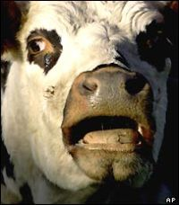
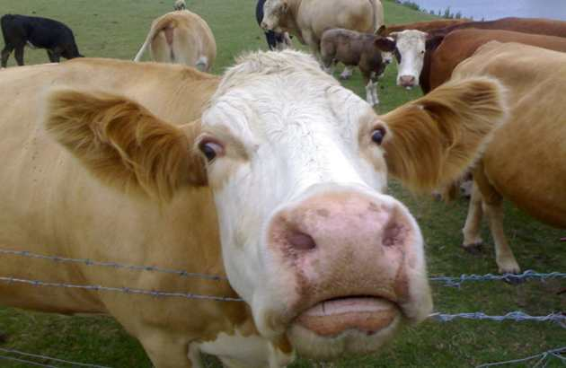
The known prion diseases include:
Creutzfeldt-Jakob disease (in humans)
Scrapie (in sheep)
Bovine spongiform encephalopathy, BSE =
("mad cow disease" in cattle)

Slide 32
Transmissible spongiform encephalopathies, (TSEs)

Slide 33
Prions lack nucleic acid and propagate by transmission of protein misfolding

Slide 34
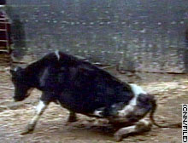
Mad Cow: BSE

Slide 35
Occurrence of Infectious Diseases
Epidemiology
=the study of the occurrence of disease in populations.
Epidemiologists are concerned not only with infectious diseases, but also with noninfectious diseases such as cancer and atherosclerosis, and with environmental diseases such as lead poisoning.

Slide 36
Vocabulary:
Epidemiology
Reservoir
Transmission
Indirect and direct contact
Vertical vs horizontal transmission
Vector
Outbreak vs Epidemic vs Pandemic
Morbidity vs Mortality
CDC, WHO, USAMRID

Slide 37
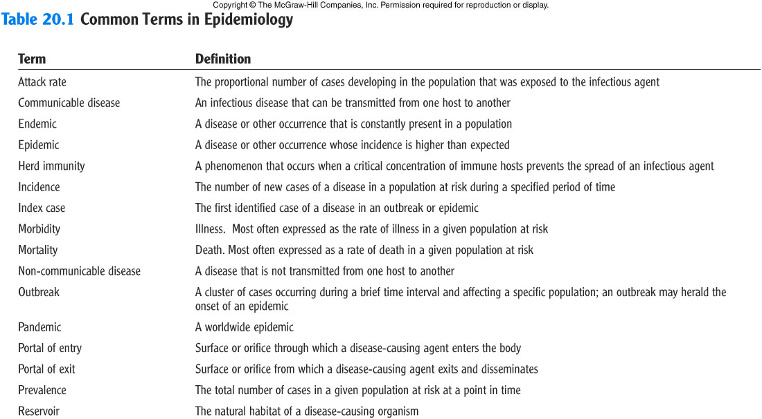
Common Terms

Slide 38
Work of epidemiologists includes:
identifying unusually high incidences of a particular disease
determining the effectiveness of a vaccine
calculating the cost effectiveness of various means of controlling disease transmission.
Being "detectives" who track down the cause of a "new" disease, determine its reservoir and mode of transmission, and help organize various health care workers to bring the disease under control.

Slide 39
Disease reservoir:
is the site where the infectious agent survives.
=long-term host of the pathogen of an infectious disease. It is often the case that hosts do not get the disease carried by the pathogen
Animals often serve as reservoirs for diseases that infect humans.
The major reservoir for Yersinia pestis, the bacteria that causes plague, is wild rodents.
Snails = reservoir for Schistosomiasis.
There are also nonliving reservoirs.
Soil is the reservoir for many pathogenic fungi as well as some pathogenic bacteria such as Clostridium tetani, which causes tetanus.

Slide 40
Living reservoir →
Nonliving reservoirs

Slide 41
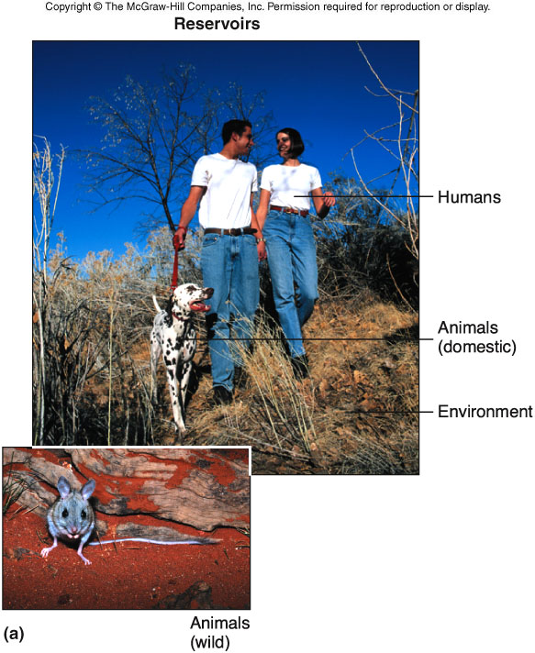
Pathogen Reservoirs
Humans are the most important reservoir of human infectious disease.
Ex. measles

Slide 42
Modes of transmission
Infectious agents may be transmitted through either
direct or indirect contact.

Slide 43
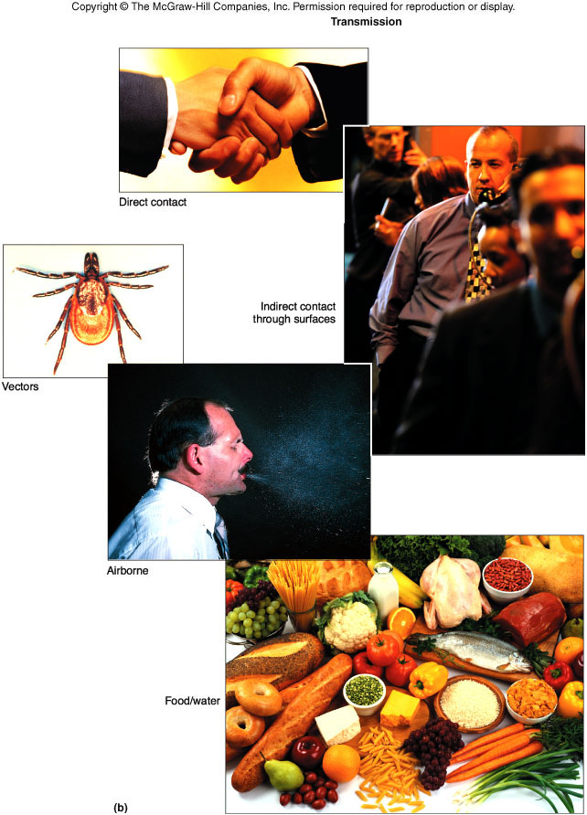
Pathogen Transmission

Slide 44
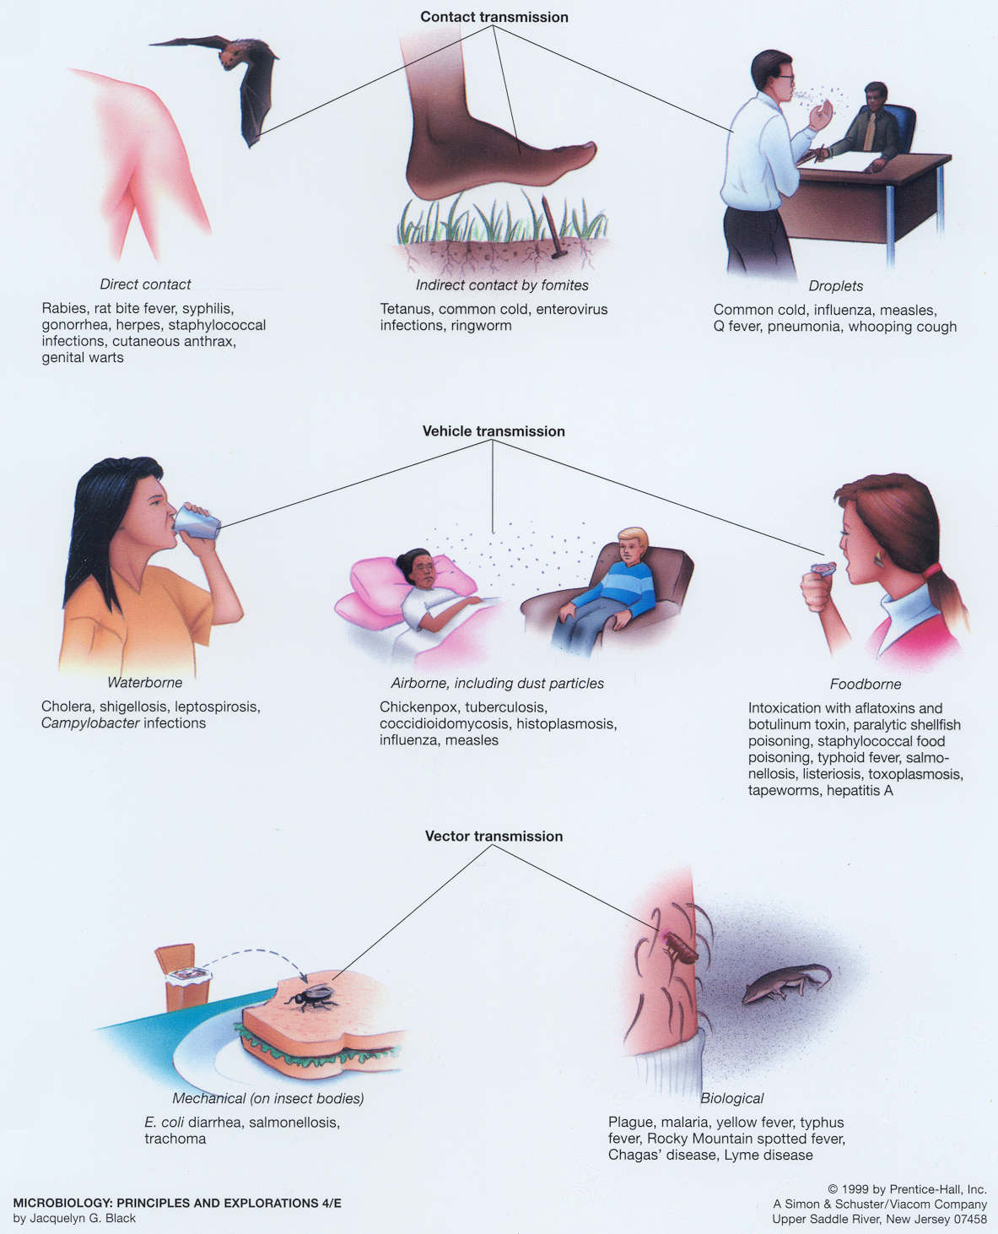
Modes of Transmission

Slide 45
Direct contact
when disease-causing microorganisms pass from the infected person to the healthy person via direct physical contact with blood or body fluids.
Examples:
touching,
kissing,
sexual contact,
contact with oral secretions, or
contact with body lesions.

Slide 46
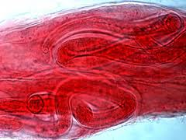
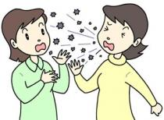
Direct Contact…
Some diseases that are transmitted primarily by direct contact with the reservoir include ringworm, AIDS, trichinosis, influenza, rabies, and malaria.
Trichinosis caused by eating undercooked pork
Influenza passed by sneezing.

Slide 47
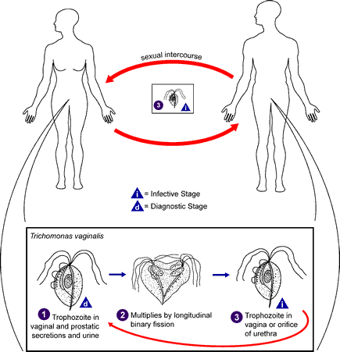
Direct-Contact Transmission

Slide 48
Indirect contact
-occurs when a pathogen can withstand the environment outside its host for a period of time before infecting another individual.
when there is no direct human-to-human contact.
Contact occurs from a reservoir to contaminated surfaces or objects, or to vectors such as mosquitoes, flies, mites, fleas, ticks, rodents or ingesting food and beverages contaminated by contact with a disease reservoir (as opposed to infected with)
The fecal-oral route of transmission, in which sewage-contaminated water is used for drinking, washing, or preparing foods

Slide 49
Indirect-Contact Transmission
Methicillin-resistant Staphylococcus aurius (MRSA)?
Beddings are an example of a Fomite, an inanimate object that can transmit pathogens between people.

Slide 50
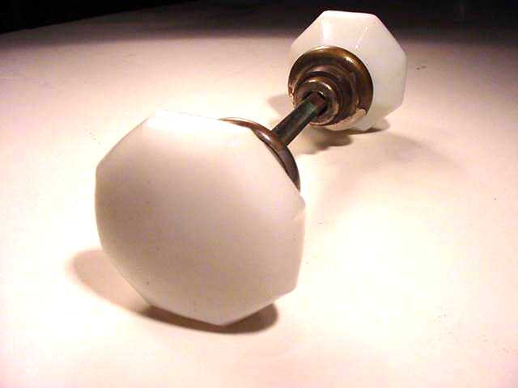
Indirect-Contact Transmission
Influenza virus?
Door knobs are another good example of a fomite.

Slide 51
Contact Transmission
Rhinovirus?

Slide 52
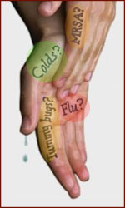
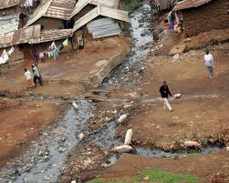
Indirect Contact…
Examples of diseases transmitted by indirect contact are influenza. Also gastrointestinal diseases such as cholera, rotavirus infection, cryptosporidiosis, and giardiasis through contaminated water.

Slide 53
Droplet Transmission
Less than
one meter
Measles?

Slide 54
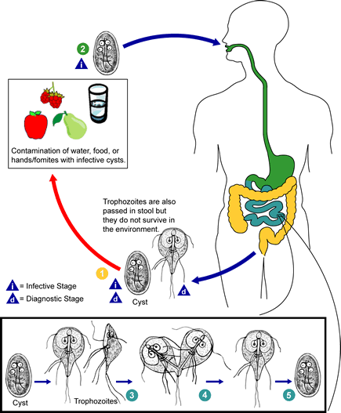
Direct Fecal-Oral Transmission
Giardiasis in daycare centers.

Slide 55
Horizontal Transmission
the infectious agent is passed from person to person (or host to host) in a group.
through of direct and indirect contact

Slide 56
Vertical Transmission
transmitted from parent to child during the processes of reproduction
through sperm or egg cells
fetal development
birth.
Diseases in which vertical transmission occurs include AIDS and herpes encephalitis (which occurs when an infant contracts the herpes simplex type II virus during vaginal birth).

Slide 57
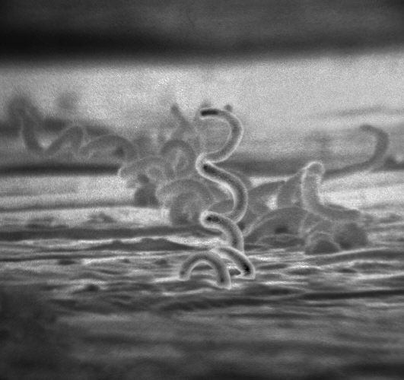
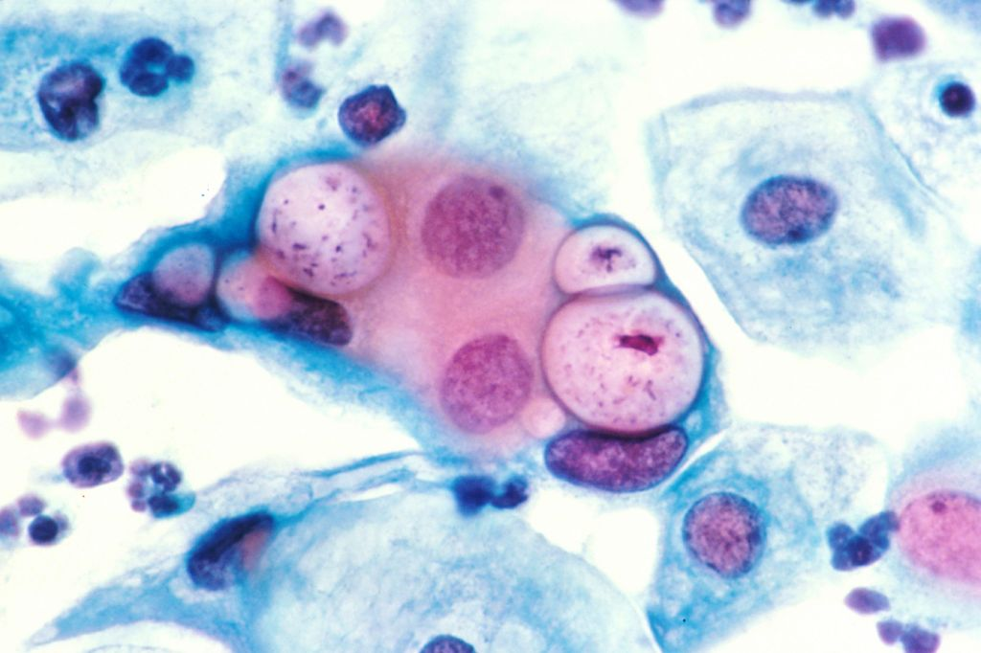
HIV Syphilis
Chlamydia
Can all be vertically transmitted diseases

Slide 58
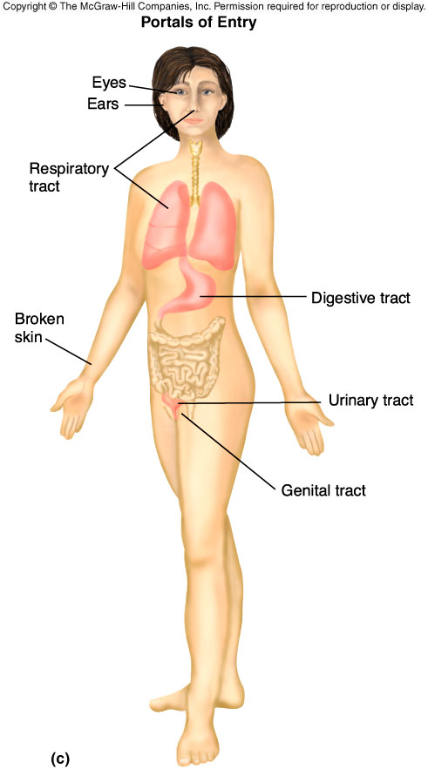
Portals of Entry

Slide 59
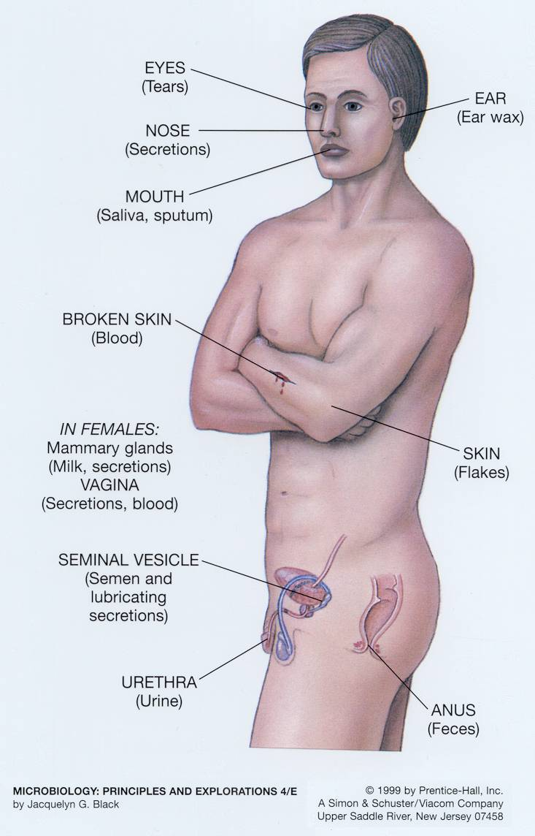
Portals of Exit

Slide 60
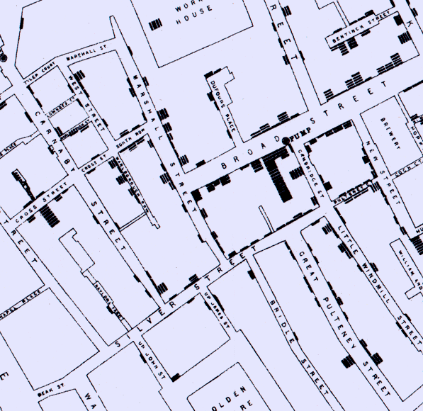
Common-Source Outbreak
The Broad Street Pump.
Individual cases of (deaths from) cholera.

Slide 61
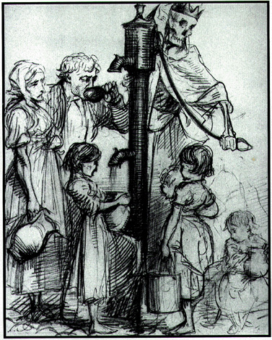
Common-Source Outbreak
The Broad Street Pump.
Cholera!

Slide 62
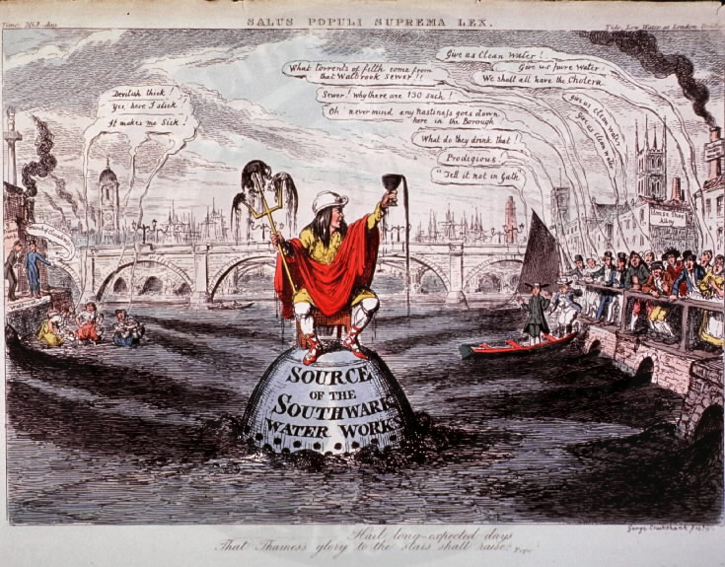
Common-Source Outbreak
Sewage contamination of drinking water.

Slide 63
Propagating Epidemic
Epidemic spreads via multiple sources.

Slide 64
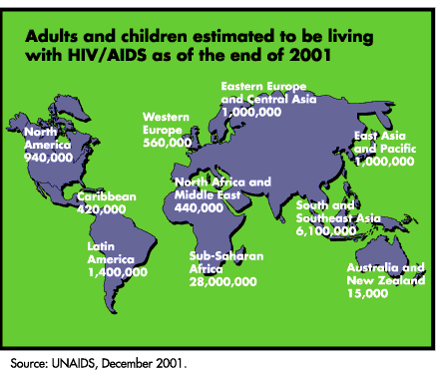
Pandemic- multinational outbreak
Index case.

Slide 65
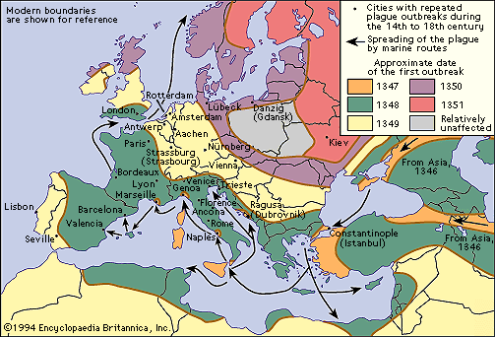
Pandemic

Slide 66
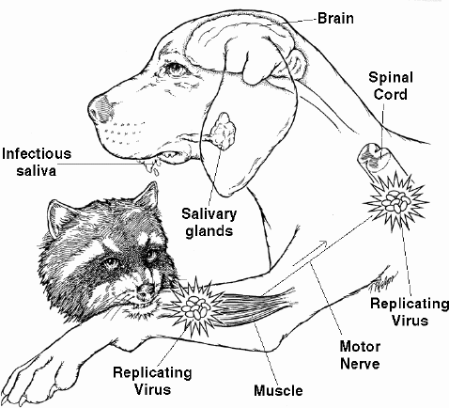
Zoonoses
Zoonoses are Human Diseases with Animal Reservoirs.

Slide 67
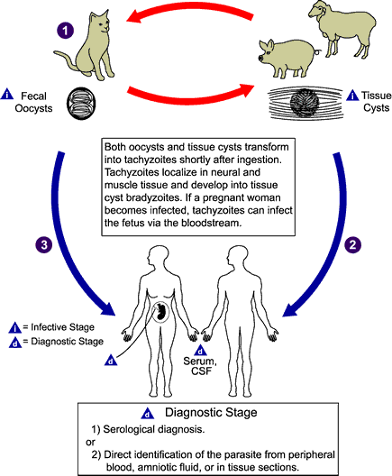
Zoonoses
Toxoplasmosis

Slide 69
Cholera in Haiti
An outbreak of cholera was confirmed in Haiti on October 21, 2010. Cholera had not been documented in Haiti for decades so cholera outbreaks were considered unlikely in Haiti immediately following the earthquake in January, 2010
Cholera info From CDC.com website

Slide 70
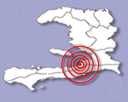
Why Haiti???
Since January 2010, CDC has worked alongside its partners to establish basic public health systems in Haiti.

Slide 71
Why Haiti?
For a cholera outbreak to occur, two conditions have to be met:
(1) there must be significant breaches in the water, sanitation, and hygiene infrastructure used by groups of people, permitting large-scale exposure to food or water contaminated with Vibrio cholerae organisms; and
(2) cholera must be present in the population.

Slide 72
Aid workers brought disease to Haiti
The origins of the strain became a hot issue in Haiti this week after the mayor of Mirebalais, a town in the middle of the outbreak, suggested that Nepalese soldiers brought it from their homeland to a nearby United Nations peacekeeping camp.
npr/blogs/health Oct 30 2010

Slide 73
Morbidity and Mortality by 10/10
As of Friday, Haitian officials had counted 4,700 cases of cholera and 330 deaths. Mintz says about 6 percent of victims have died, but public health officials hope to reduce that fatality rate to 1 percent or less.
npr/blogs/health October 2010

Slide 74
WHO Fluid Replacement or Treatment Recommendations
Rehydration is the cornerstone of treatment for cholera. Oral rehydration salts and, when necessary, intravenous fluids and electrolytes, if administered in a timely manner and in adequate volumes, will reduce fatalities to well under 1%.
Antibiotics reduce fluid requirements and duration of illness. Antibiotics are indicated for severe cases

Slide 75
Five Basic Cholera Prevention Messages
1) Drink and use safe water.
2) Wash your hands often with soap and safe water.
3) Use latrines or bury your feces (poop); do not defecate in any body of water.
4) Cook food well, keep it covered, eat it hot, and peel fruits and vegetables.*
Boil it, Cook it, Peel it, or Leave it.
* Avoid raw foods other than fruits and vegetables you have peeled yourself.
5) Clean up safely—in the kitchen and in places where the family bathes and washes clothes.

