Slide 1
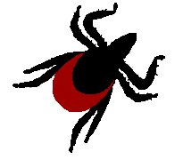
Lyme Disease and other Zoonoses

Slide 2
What are Zoonoses?
These are diseases where the pathogen dwells and replicates in the bodies of nonhuman, vertebrate animals such as rodents, birds, bats or livestock usually without causing disease.
  The vertebrates species are the ‘reservoirs’
Pathogens pass to humans via the bite of a vector (usually an arthropod)
  It is thought that up to 75% of most emerging infectious diseases are zoonoses.

Slide 3
What is the Role of the Reservoir?
Some pathogens can exist and be transmitted outside reservoir/host – ex Hantavirus in dried rodent urine
Other pathogens must be in an animal body and be directly transferred, for example by a bite. Ex. Rabies/Lyme.

Slide 4
What is the Role of the Reservoir?
Pathogen replicates within the reservoir until it is transported by vector to the next host.
Lyme Bacteria have MANY Reservoir Hosts!

Slide 5
What is the role of the Vector?
To pass the pathogen to humans usually through a blood-feeding bite.
Vectors are usually Host Generalists:
  =willing to bite a variety of host species.
    Horizontal transmission - common– vectors acquire pathogens during a blood meal from host. – therefore the pathogen requires the host to perpetuate the disease.
    Vertical transmission- vector may pass pathogen on to offspring – RARE
  Vector for LYME is the black legged tick

Slide 6
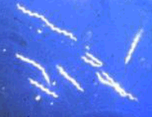
What Is Lyme Disease?
Bacterial Infection→ Borrelia burgdorfii
  =Spirochete bacteria
Primarily transmitted by ‘Black-legged’ tick
Affects both animals and humans

Slide 7
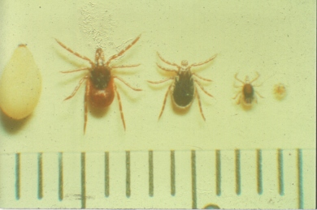
“Family Portrait”
Adult Nymph Larva Egg

Slide 8
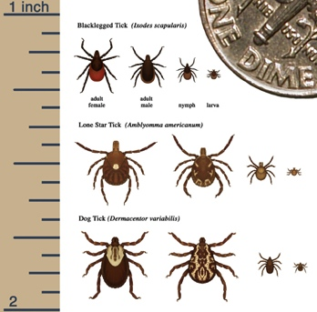

Slide 9
Tick Facts...
Ticks must be attached 36 - 48 hours to transmit bacteria
Larval ticks most active in midsummer
Nymphal ticks most active late May thru July
  Nymphal ticks cause majority of Lyme cases
Adult ticks most active late Oct. and early November.

Slide 10
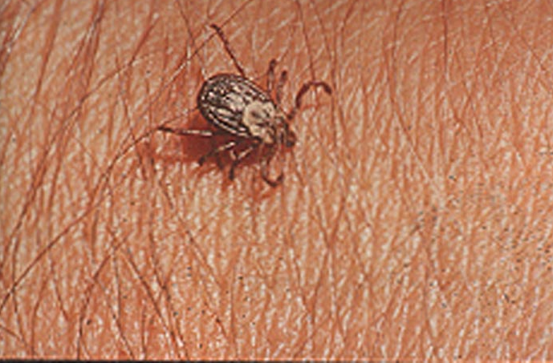
Wood Tick
Larger than Deer Tick
Does NOT transmit Lyme

Slide 11
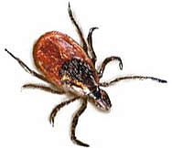
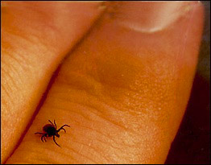
Adult Black legged Tick

Slide 12
TWO YEAR LIFE CYCLE
Three Active Stages –
  molts→ next stage
Need ‘vertebrate host at each stage
(Such as mouse, animal or person)
ONE blood meal/stage
  Each tick has 3 blood meals in life:
    First meal– may acquire Lyme.
    Only second or third can transmit it.

Slide 13
Tick Facts:
Ticks:
  Are not born infected with bacteria
    No vertical transmission in ticks
  Do NOT fly or jump
    Attach as host passes by
  Must be attached for 24-48 hours before Lyme can be transmitted!

Slide 14
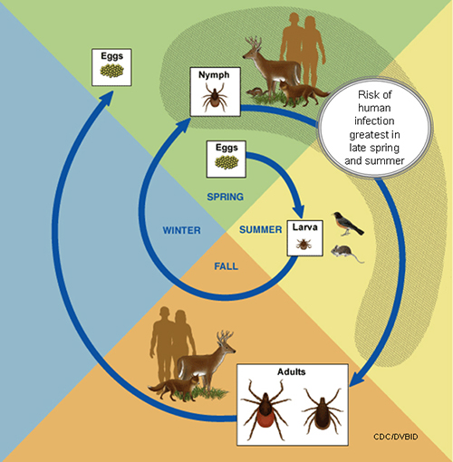
Black legged Tick Life Cycle

Slide 15
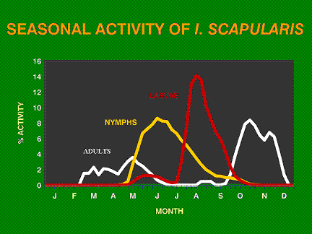

Slide 16
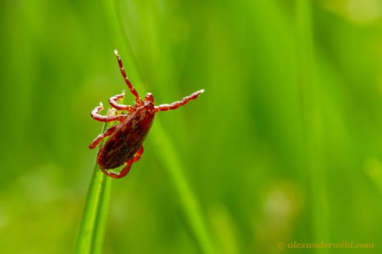
How does a tick find its host?
-by detecting animals´ breath and body odors, or by sensing body heat, moisture, and vibrations.
-Ticks rest on the tips of grasses and shrubs.
-”Questing”: they hold onto leaves and grass by their third and fourth pair of legs. They hold the first pair of legs outstretched, waiting to climb on to the host. When a host brushes the spot where a tick is waiting, it quickly climbs aboard.

Slide 17

How does tick acquire/transmit infections?
When the tick finds a feeding spot, it grasps the skin and cuts into the surface.
Tick Mouthparts
(barbed hypostome in center
anchors tick as it feeds)
The tick then inserts its feeding tube. Many species also secrete a cement-like substance that keeps them firmly attached during the meal. The feeding tube can have barbs which help keep the tick in place.

Slide 18
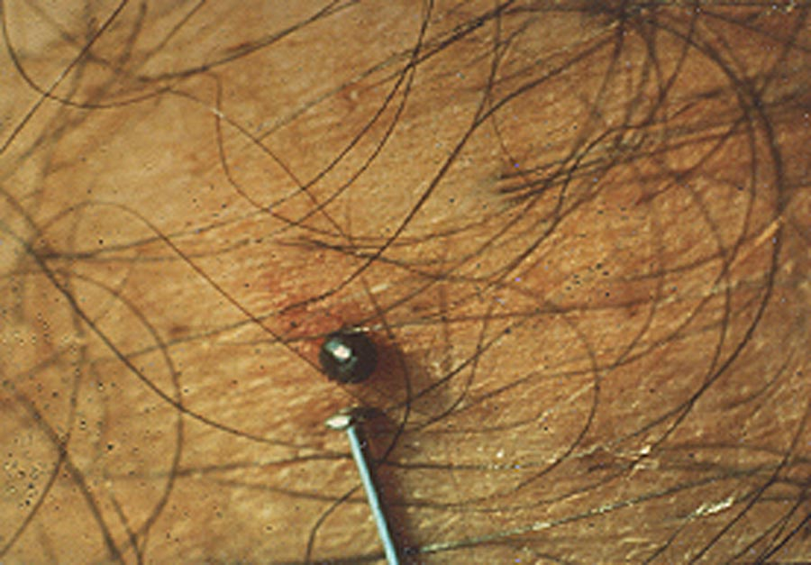
Ticks can secrete small amounts of saliva with anesthetic properties so that the animal or person can't feel that the tick has attached itself.
A tick will suck the blood slowly for several days
Engorged Nymphal Tick

Slide 19
Exchange of pathogens!
If the host animal has a bloodborne pathogen, the tick will ingest the pathogens with the blood.
  Small amounts of saliva from the tick may also enter the skin of the host animal during the feeding process.
If the tick contains a pathogen, the pathogen may be transmitted to the host animal.
After feeding, most ticks will drop off and prepare for the next life stage. At its next feeding, it can then transmit an acquired disease to the new host.

Slide 20
How does a tick infect its host with Lyme?
When B. burgdorfii spirochetes are inside a tick – they tend to stay in the midgut.
When tick attached to host and blood enters the midgut, the bacteria are stimulated to migrate through the gut lining into the circulatory system.
Spirochetes migrate to tick’s salivary glands within the next 48 hours.
From there the spirochetes are injected into the tick’s host.

Slide 21
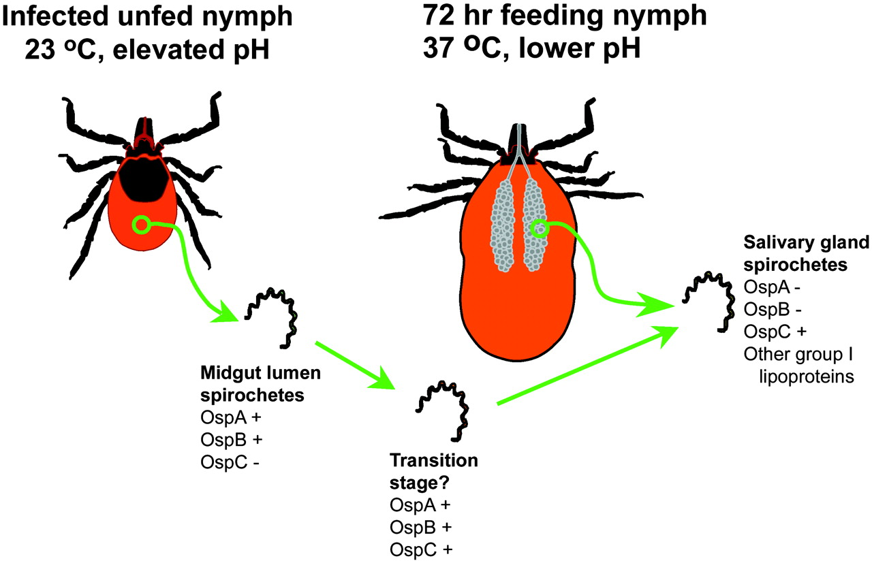

Maturation of borreliae within the tick midgut.
Templeton T J J Exp Med 2004;199:603-606
© 2004 Rockefeller University Press
Notes:
Maturation of borreliae within the tick midgut. Unfed infected nymphs acquire infection from a previous feed during the tick larval stage. Midgut borreliae are quiescent and express group II stage lipoproteins, predominantly OspA and OspB. During a nymphal stage feed on a new host in response to changes in temperature and pH the borreliae begin expressing OspC and other group I stage lipoproteins (e.g., DbA/B, Mlp, Erp, and vslE).

Slide 22

Vertebrate Hosts
Hosts include: mice, white tailed deer, raccoon, shrew, chipmunk, skunk, opossum, squirrel, veery, catbird, robin
LD spirochete is a HOST GENERALIST as are the ticks that transmit the disease:
Ticks have been found on at least 125 North American vertebrate species and 27 species of mammals
  White-footed mice serve as the principal reservoirs of infection on which many larval and nymphal ticks feed and become infected with the LD spirochete.

Slide 23
Biodiversity
= ‘totality of genes, species, and ecosystems of a region’
In this case we are looking at the variety of species populations present.
What is the link between Biodiversity and Lyme Disease???

Slide 24
Greater Biodiversity leads to less Lyme disease risk
Increasing biodiversity causes a decrease in pathogen transmission or disease risk. - termed the Dilution Effect
In the case of Lyme, the more vertebrate hosts in an ecosystem, the more spread out (dilute) the ticks will be among those hosts.
Key to this is that all hosts are not equal when it comes to passing along the LD bacterium.

Slide 25
Which hosts are important in infecting ticks with Lyme disease?
WT Deer – Inefficient reservoirs – only infect about 1% of larval ticks feeding on them
WF Mice – Highly efficient infecting 75%-95% of larvel ticks feeding on them
Intermediate (50%) are chipmunk, shrews, Robins and all other hosts are far less efficient reservoirs

Slide 26
Reservoir Competence
= how well a host supports and transmits a pathogen
Some hosts are irritated by the tick and kill or injure the ticks by vigorous grooming, scratches or bites,or they may lick the tick off.
Other hosts’ immune systems respond to the tick saliva and other antigens from the tick mouthparts. Some launch strong antibody responses that kill the tick.*
* Vaccine development has recently focused on antibody responses to host ticks rather than to the bacterium!

Slide 27
Landscape Management
If increasing Biodiversity reduces Lyme risks – what measures could be taken toward this end?
On the state level?
The Community level?
By an individual homeowner?

Slide 28
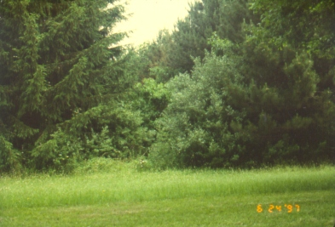
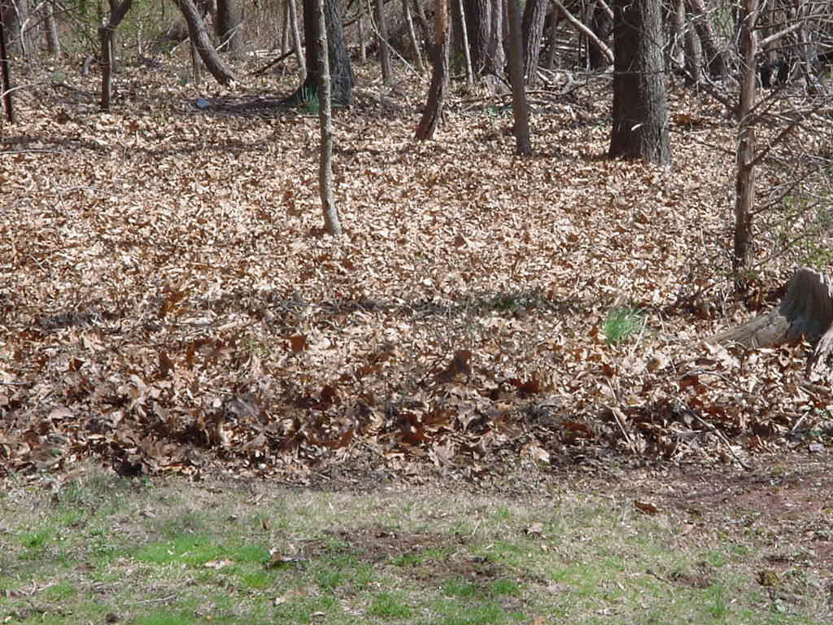
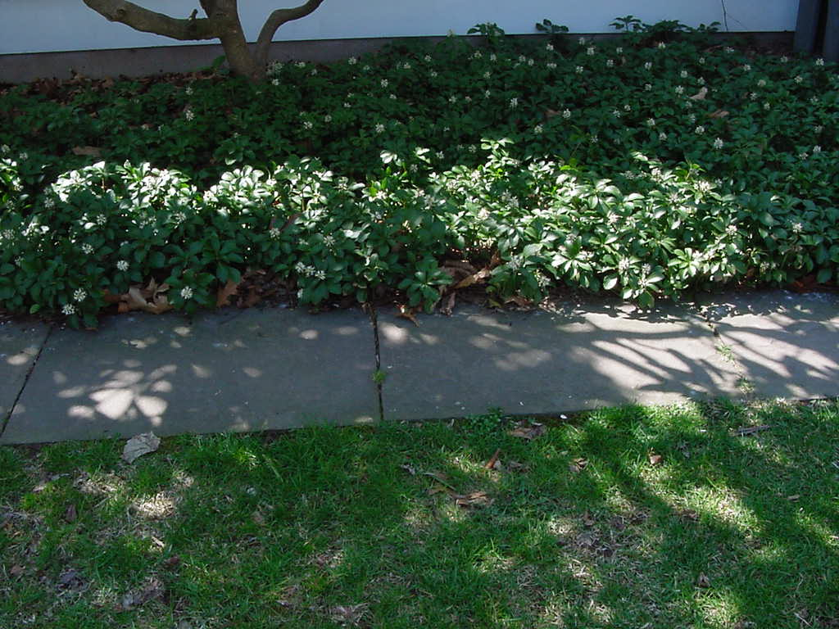
Common Tick Habitats
Tall grassy areas
Leaf litter
Ground cover
Low bushes / shrubs
Need moisture to survive

Slide 29
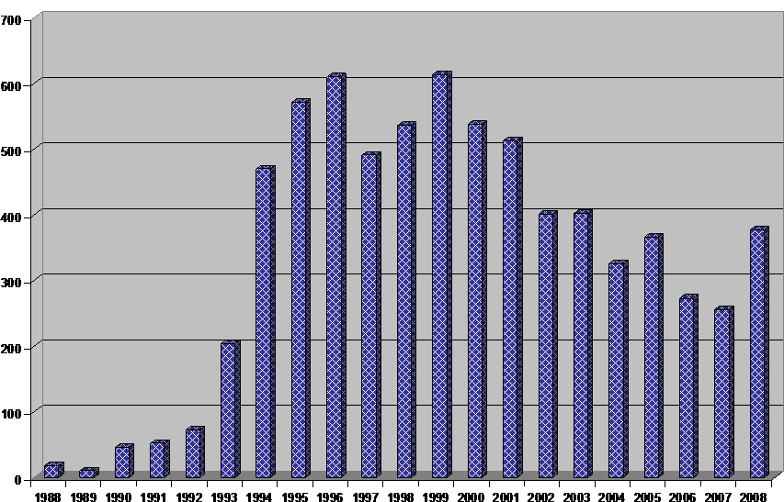
Reported Lyme Disease Cases
Number of Confirmed Lyme Disease Cases by Report Year – Hunterdon County, 1988 to 2008

Slide 30
Typical Seasonal Distribution of Reported Lyme Disease Cases

Slide 31
LYME cases by Age

Slide 32
Signs and Symptoms of Lyme Disease

Slide 33
Clinical Manifestations
Early Lyme (Days to month after bite)
-- Erythema Migrans (‘Bull’s Eye Rash’)
-- +/- Flu-like symptoms
Early Disseminated Lyme / Late Lyme
-- Neurologic or cardiac abnormalities
-- Musculoskeletal symptoms
-- Migratory arthritis

Slide 34
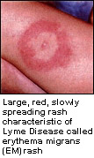

Slide 35
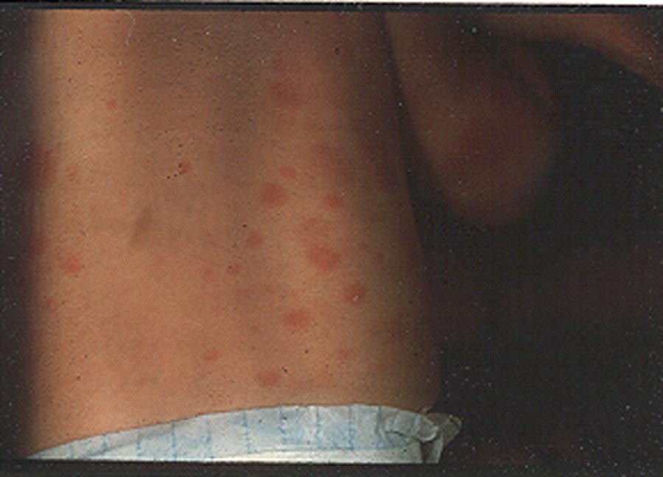

Slide 36
Recommendations for Testing
No blood test if rash present
Two-test approach
ELISA test
Western Immunoblot for positive or equivocal ELISA

Slide 37
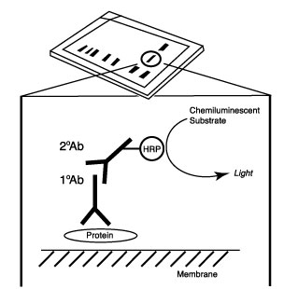
Western Blot
Electrophoresis of proteins from infected material sample followed by an enzyme tagged antibodies to probe for the target protein (antigen)
A color change occurs when the enzyme substrate is added indicating a positive test.
Notes:
The western blot is a widely used to detect specific proteins in the given sample of tissue homogenate or extract. It uses gel electrophoresis to separate proteins The proteins are then transferred to a membrane where they are probed (detected) antibodies specific to the target protein.[

Slide 38
TREATMENT
Doxycycline, amoxicillin, and ceftin
Usually treated for 4-6 weeks.

Slide 39
Ostfeld video - ~ 8 min
Ostfeld American Museum of Natural History video
NYC FORUM on Tick Borne Diseases 3/12
52:30 – 1:01:10 - Ostfeld

Slide 40
Personal Protection Measures to Reduce Your Risks

Slide 41
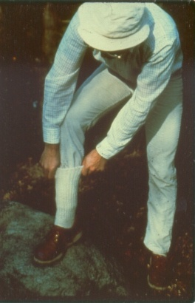
Before going out...
Wear light-colored clothing
Tuck shirt into pants and pants into socks
Wear ‘closed’ shoes

Slide 42
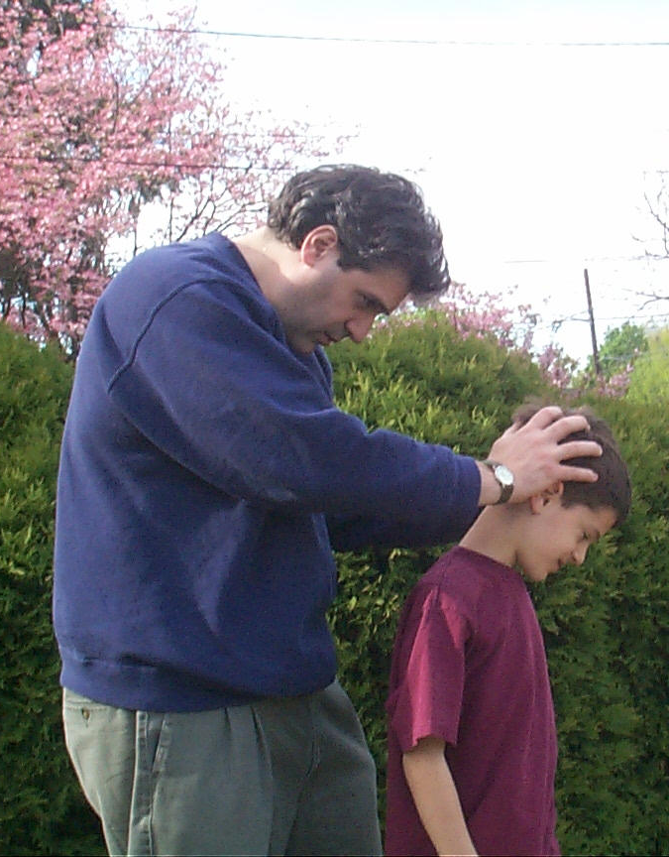

Perform
Frequent Tick
Checks….
…while in tick habitats AND when returning home

Slide 43
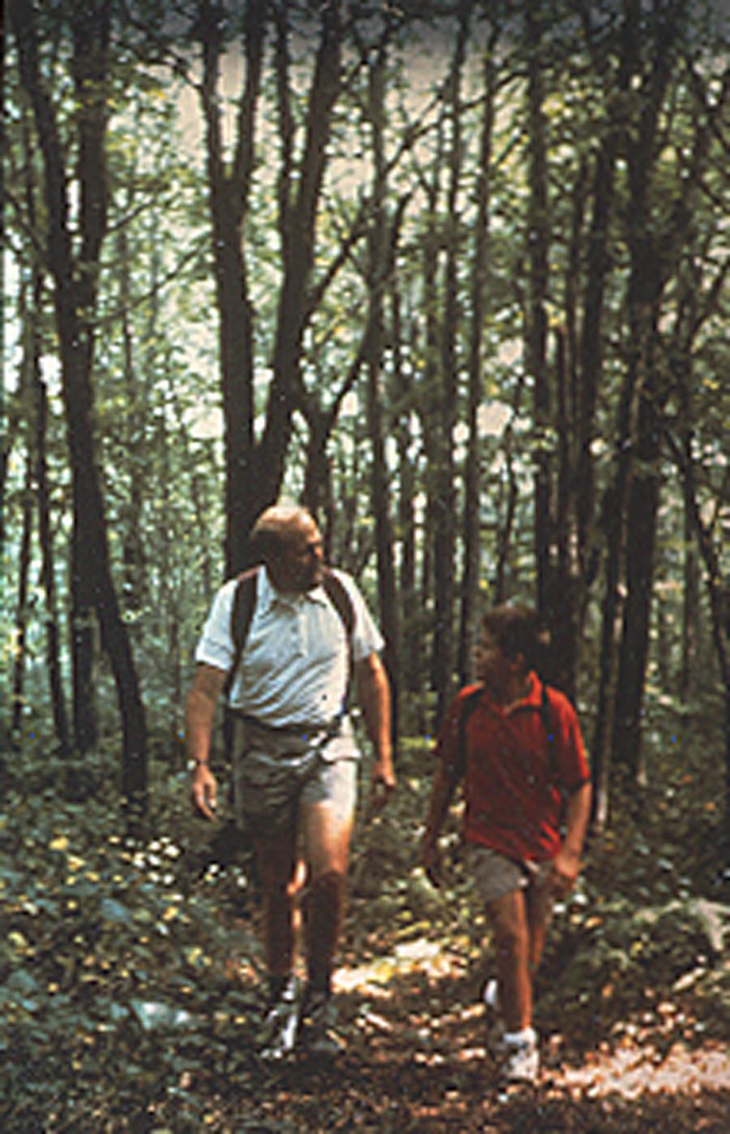
Avoid ‘tick-friendly’ habitats when possible
Keep to center of path

Slide 44
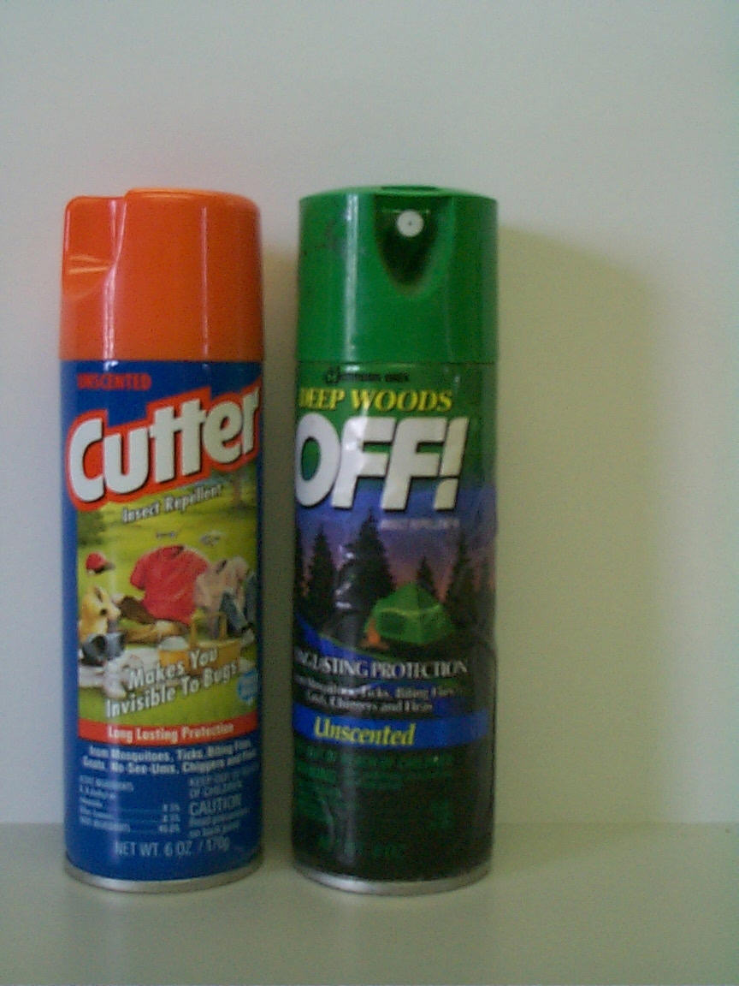
Tick Repellents for Personal Use
30% - 40% DEET content most effective for ticks
Use on skin or clothing
Target shoes, pant legs
Not for children < 3 yrs
See guidelines for children
FOLLOW DIRECTIONS CAREFULLY

Slide 45
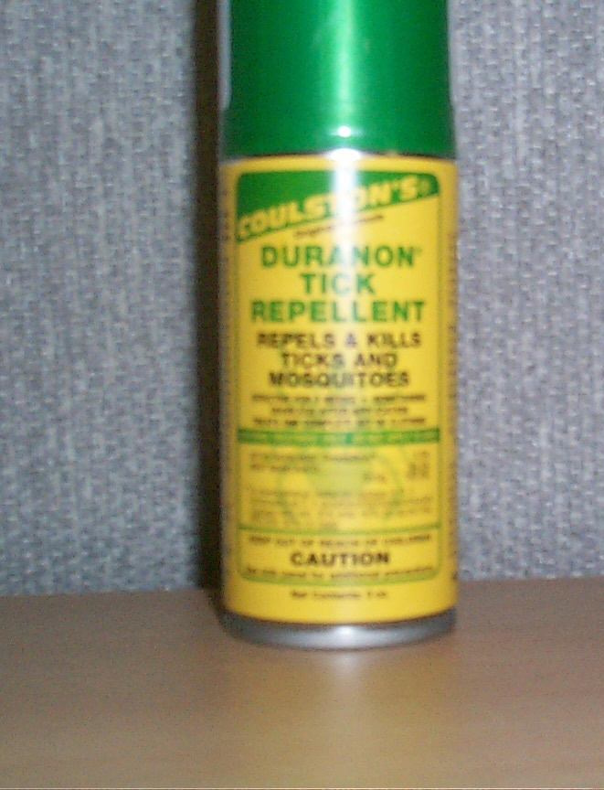
Tick Repellents for Personal Use
Permethrin-containing products
USE ON CLOTHING ONLY
Insecticide
FOLLOW DIRECTIONS CAREFULLY

Slide 46
Using ‘Host Reduction’ to Reduce Risks for Lyme Disease

Slide 47
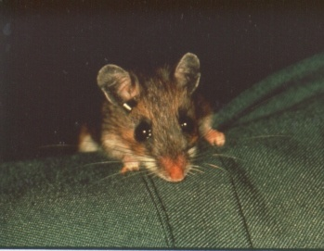
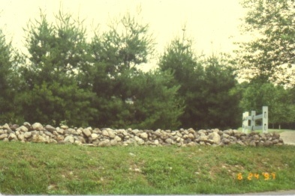
Move birdfeeders and firewood away from family activity area (like picnic and/or play area)
Avoid common ‘host habitats’

Slide 48
Ehrlichiosis
A disease caused by bacteria in the genus Ehrlichia. 2 types have been identified in the U.S.: HME and HGE. Transmitted by the deer tick.
It is considered an acute infection without chronic long-term consequences. The severity of the disease varies from person to person. May be life-threatening or fatal for elderly and others with compromised immune systems.

Slide 49
Symptoms
Person may be asymptomatic or may have mild to severe symptoms.
Initial symptoms include fever, headache, malaise, and muscle aches. Other symptoms include nausea, vomiting, diarrhea, cough, and joint pains. May also have a rash. Severe complications include prolonged fever, renal failure, seizures, or coma.
As many as half of all patients require hospitalization. 2-3% of patients die from the infection.

Slide 50
Treatment
Treatment should be initiated immediately when there is suspicion of Ehrlichiosis. Treatment should not be delayed until lab confirmation is obtained.
100 mg. Doxycycline twice daily for a minimum of 7 days. Severe cases may require longer treatment.

Slide 51
Babesiosis
Babesiosis is a malaria-like illness caused by a protozoan parasite (Babesia microti in the U.S.) that is primarily transmitted by the black-legged deer tick.

Slide 52
Symptoms
May be asymptomatic; symptoms include fever, chills, sweating, muscle aches, fatigue, and hemolytic anemia. Symptoms typically occur after an incubation period of 1-4 weeks, and can last several weeks. Disease is more severe in the elderly and immunosuppressed individuals.

Slide 53
Treatment
Clindamycin + quinine or atovaquone plus azithromycin for 7 days.

