Slide 1
BACTERIA

Slide 2
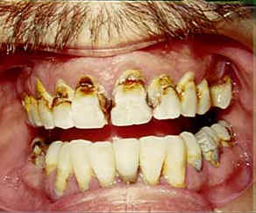
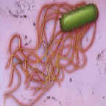
Domain Bacteria:
Masters of Every Environment
Bacteria exist in staggering numbers in wide range of habitats. Bacteria enormously diverse: 4,000 to 5,000 species found living in 1 gm of forest soil.
    1. Microflora of human gut includes 600 species of bacteria in mouth alone; One quarter of feces by weight consists of bacteria.
YUCH!
Gut bacteria

Slide 3
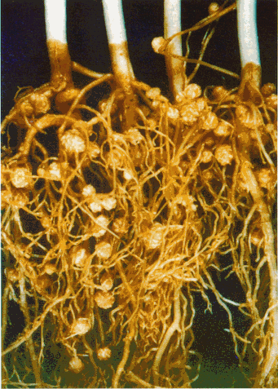
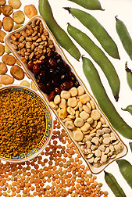
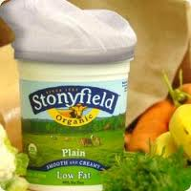
    2. Nitrogen-fixing bacteria have symbiotic relationship with some plants: convert molecular nitrogen into forms usable by plant; nitrogen needed by animals comes ultimately from plants.
    Bacteria play an important role as decomposers (as in city sewage plants
    We use bacteria to create food products! Yogurt, sauerkraut, cheese

Slide 4
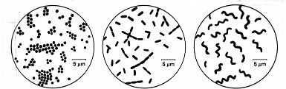
  Bacteria varied in shapes:
    1. Cocci--spherical
    2. Bacilli—rod-shaped
    Spirochetes—spiral-shaped

Slide 5
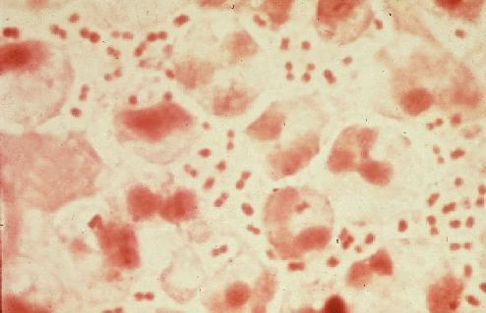
Some bacteria names have prefixes that describe their structure
Diplo = bacteria in pairs
  Ex – Diplococcus or Diplobacillus
This diplococcus causes gonorrhea

Slide 6
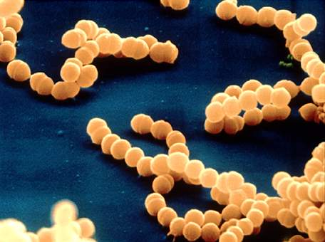
Strepto = means chain of cells
Streptococcus or Streptobacillus

Slide 7
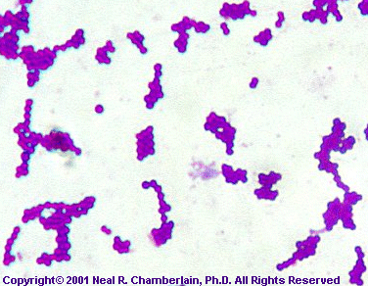
Staphylo = means cluster
Ex– Staphylococcus– a major cause of infection in hospitals

Slide 8
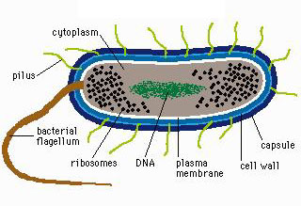
Bacteria cell - Prokaryotic
plasmid

Slide 9
  Characteristics of bacteria:
    lack cell nucleus, as do all prokaryotes (eukaryotes have nuclei).
    Have almost no other cell organelles save ribosomes
    no cytoskeleton.
    Have a cell wall of peptidoglycan
    May have pili, flagella and/or a capsule of sticky polysaccharide.

Slide 10
Bacteria – characteristics…
6. DNA is present as single chromosome; = One double-stranded, circular DNA molecule called the ‘chromosome’.
    @ 4300 genes (1/1000th human genome)
7. Nucleoid – region where chromosome is
tightly “clumped.”
8. Plasmids
Notes:
New mutations that are rare can have a significant impact because the cells divide so rapidly (in a population with a longer generation time random mutations would not impact them as much).

Slide 11
PLASMIDS
Plasmids are small circular pieces of DNA separate from the chromosome
They can be be copied and transferred from one bacterial cell to another
Plasmids are very important VECTORS in DNA TECHNOLOGY!!!

Slide 12
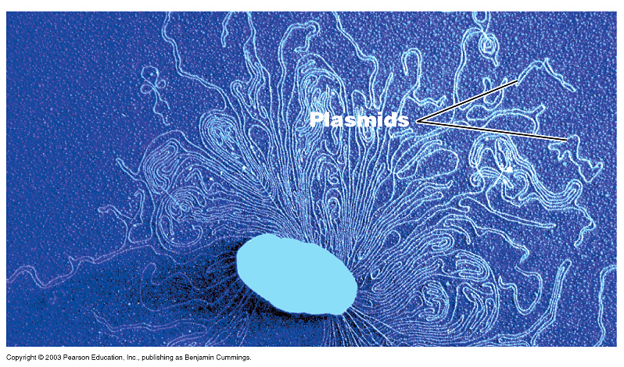

Slide 13
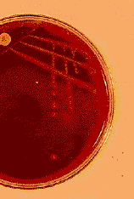

Bacteria are single-celled but may form colonies
(EACH DOT ON THE PLATE IS A COLONY MADE UP OF
MILLIONS OF BACTERIA)
Each colony is descended from a SINGLE CELL

Slide 14
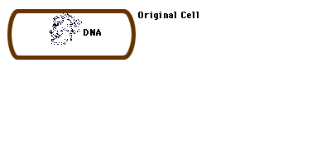
Reproduction is asexual, by simple splitting termed: Binary Fission:
    -Daughter cells are genetic clones of parent.
    -Fast generation time –as short as every 20 minutes.

Slide 15
Genetic Recombination
The combining of DNA from two individuals into the genome of a single individual.
This is not really sexual reproduction but it’s as close as it gets!
3 Ways in which this can occur:
  Transformation
  Transduction
  Conjugation
  NOTE: This happens all the time between different species of bacteria!! They share!

Slide 16
3 Ways Bacteria Transfer DNA
1. Transformation: taking up DNA from fluid surrounding the cell.
2. Transduction: When a bacteriophage infects a cell and accidentally packages some of the cell DNA in with the new viral particles.
3. Conjugation: Two bacteria attach by special pili creating a cytoplasmic bridge. A copy of the doner’s DNA travels through the pili to the recipient’s and some or all is incorporated into it’s genome.

Slide 17

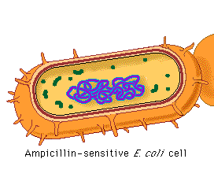
Transformation
Uptake of naked, foreign DNA from the surrounding environment.
This could be a plasmid or piece of a chromosome

Slide 18
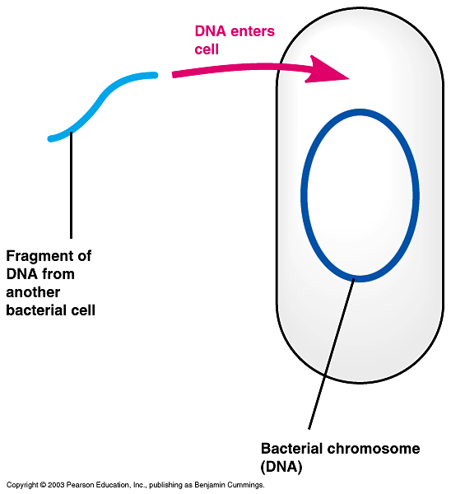
Bacterial Transformation

Slide 19
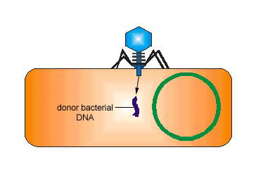
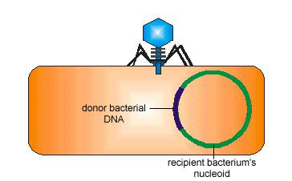
Transduction
Phages (viruses that attack only bacterial cells),
may carry bacterial genes from one host cell to another.
The phage injects a piece of bacterial DNA from a previous host into a new host cell, crossing over occurs between donor and recipient bacteria cell.

Slide 20
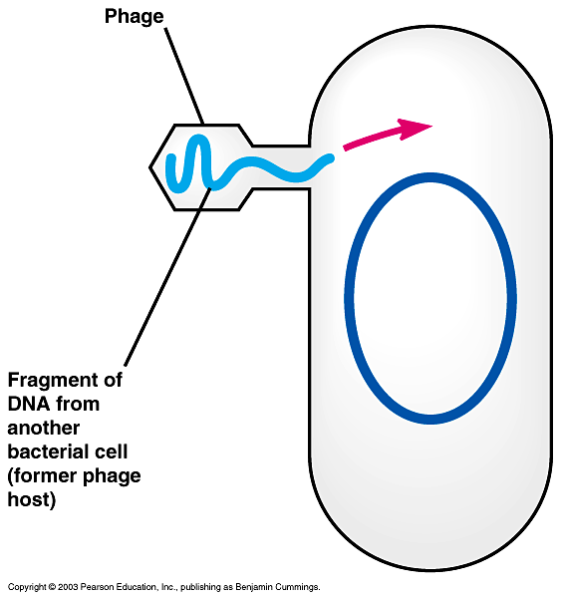
Bacterial Transduction

Slide 21
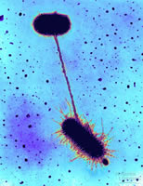
Conjugation
Direct transfer of genetic material between two bacterial cells
  Donor = male forms sex pilus. Contains F factor plasmid.
  Recipient – female
Notes:
Donor cell – F factor is donated (can be bacterial DNA or a plasmid).
Plasmids – extragenomic DNA that a cell may or may not have. If a cell has plasmid usually is referred to as F+. Episome = a genetic element that can replicate either as a plasmid or as part of the bacterial chromosome.
F plasmid - @ 25 genes, Hfr cells contain chromosome with F factor in it. This is copied and sent through pilus but not all of the chromosome will be sent so the new cell only gets a fragment that could have potentially useful genes on it.
R plasmid – R = resistance contain antibiotic resistance.
Transposons – “jumping genes” they can move (transposition) from one site in the DNA to another site (they contain an enzyme that allows them to do this). Sometimes they will transpose the genes for resistance to many different antibiotics into one plasmid by moving back and forth between genomic and plasmid DNA. The enzyme transposase recognizes specific insertion sequences that flank the DNA / gene to be transposed.

Slide 22
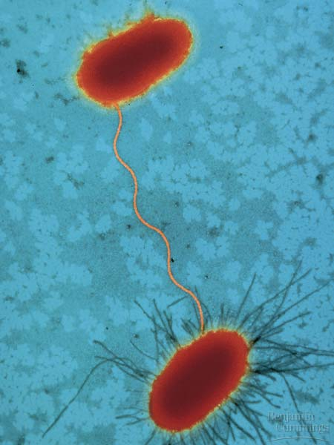
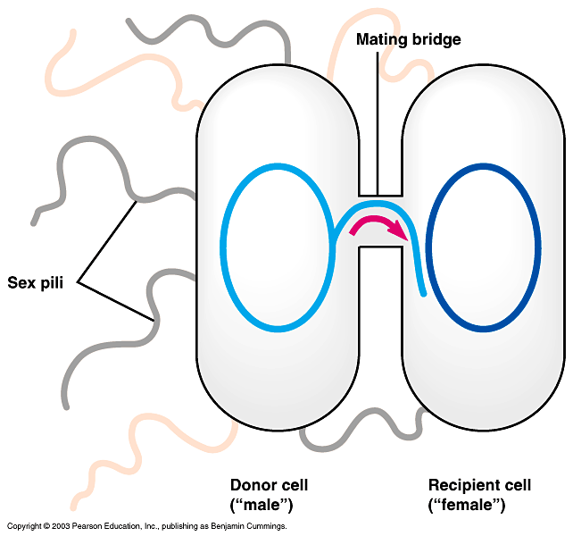
Bacterial Conjugation

Slide 23
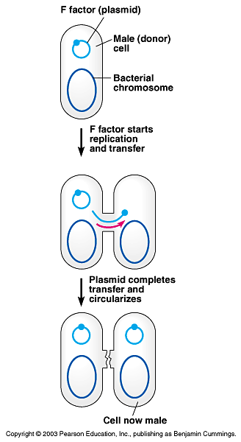
Transfer of Plasmid by conjugation
F – factor plasmid – makes recipient able to create sex pili (fertile)
R- Factor plasmid makes recipient resistant to certain antibiotics

Slide 24
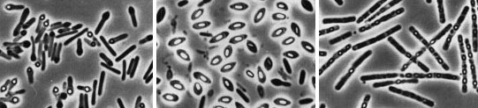
Endospores
–
Thick coated resistant cell produced within a bacterial cell exposed to harsh conditions.
Preserves the cell during hard times– not a form of reproduction : Contain DNA and little else
Water is removed and metabolism halts…cell disintegrates around it.
Resists destruction even at temps over 100’ C!

Slide 25
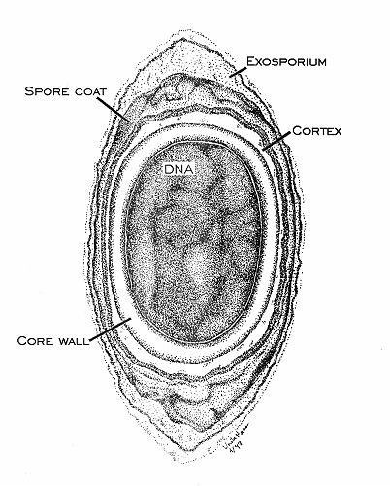
ENDOSPORES
Bacteria that are harmful to humans and that form endospores:
Clostridium tetani causes tetanus.
Clostridium botulinum
causes deadly botulism food poisoning.
Bacillus anthracis -
causes Anthrax- may remain in soil for years.

Slide 26
Endospores…
To kill endospores, equipment must be
heated to 121’C under high pressure.
Endospores may remain viable for centuries
When conditions improve they can
rehydrate and resume metabolism.

Slide 27
Gram Staining
Gram Staining divides bacteria into two major groups.
Aids in identification of bacteria based on cell wall composition.

Slide 28
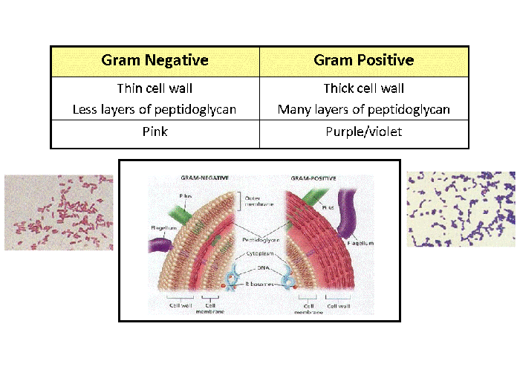
Gram Staining
Stains bacteria on the basis of their cell wall structure.

Slide 29
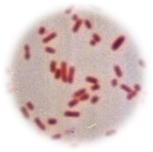
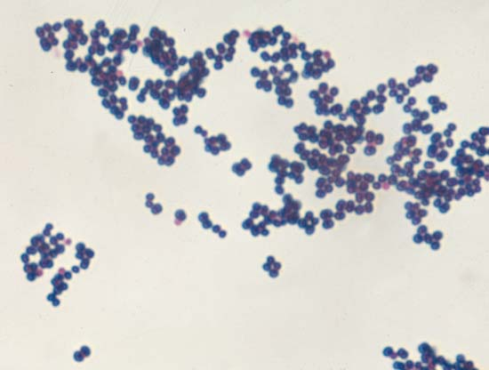
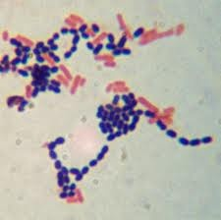
Cell Wall Composition –
Gram NEGATIVE Gram POSITIVE
Stains PINK stains BLUE

Slide 30
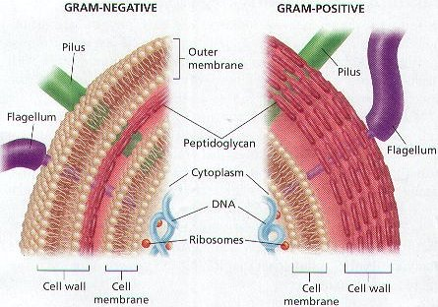

Slide 31
Characteristics of G bacteria
Gram +
  Produce EXOTOXINS
  Released as a normal part of their metabolism
  Among the most toxic substances known
  Not very heat stable

Slide 32
Characteristics of G- bacteria
Gram –
  Produce ENDOTOXIN as part of their cell wall
  These toxins only exert an effect when bacteria die.
  Heat stable – not destroyed by heat

Slide 33
Examples
  Pathogenic gram-positive bacteria Staphylococcus aureus, which causes skin, respiratory, and wound infections, and
  Clostridium tetani, which produces a toxin that can be lethal for humans.
  ALSO gangrene, botulism, diptheria and scarlet fever
  Pathogenic Gram-negative organisms Salmonella typhi, which causes typhoid fever, and
  Yersinia pestis, which causes plague.
  Also urinary tract infections and meningococcal meningitis

Slide 34
Other ways to identify bacteria:
Respiration – process of getting energy from food.
Bacteria differ in their need for oxygen.
  Three categories:

Slide 35
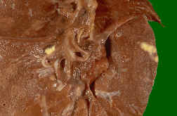
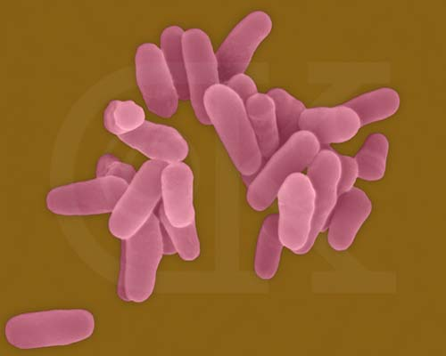
  AEROBES
  Need oxygen
    Obligate Aerobes - Can’t live without oxygen.
      EX – TUBERCULOSIS BACTERIUM
Tb lung

Slide 36
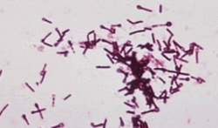
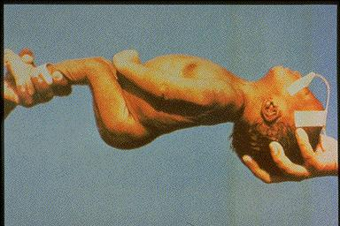
Obligate Anaerobes
  Cannot live in oxygen environment.
EX – TETANUS:
This baby probably
got tetanus from
honey – don’t give
honey
to a baby!

Slide 37
Do you ….
feel your Cytokine levels increasing yet???

Slide 38
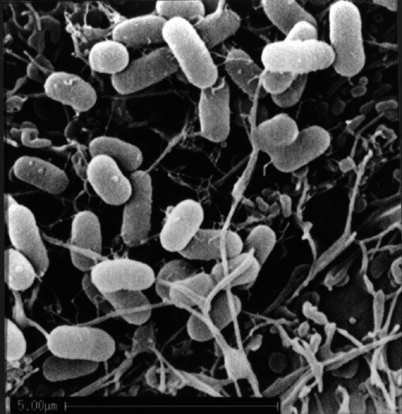
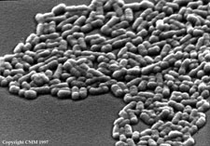
    Facultative Anaerobes:
    - CAN LIVE WITH OXYGEN BUT PREFER TO LIVE WITHOUT IT =
E. coli

Slide 39
What conditions do bacteria need for the best growth?
Food source (your soup is good)
Proper temperature - human pathogens (disease causers) live best at 98.6 F.
Moisture
Oxygen (aerobes) or not (anaerobes)
Change any of these and the growth of bacteria can be slowed down or stopped.

Slide 40
We compete with bacteria for our food – they eat the same stuff we do…. How do we preserve our food?
Drying (prunes)
salting
refrigeration
pickling
freezing

Slide 41
Most bacteria are harmless.
Remember, bacteria cells out number our own cells by a factor for 10:1!
On Earth that factor is about
1000-1,000,000 to 1!
Bacteria that inhabit our bodies actually PROTECT us from harmful pathogens by “colonization resistance” →We occupy this space so ‘get lost’.
Notes:
Some bacteria are harmless. Your skin, mouth, bowels and other places are filled with them. Many are even necessary to your survival because they help digest food or keep infectious organisms at bay. Cows could not digest grass without bacteria in their stomachs. The troublemakers are the ones that are able to make harmful chemicals that act like acids or poisons. Botulism, for instance, is caused by a bacterial poison. Pus, for the most part, is the body's response to illness. It's a collection of white cells that the body recruits for an area of infection. At other times, bacteria are so irritating to your system that your own body's defenses go overboard and attack not only the bacteria but also the tissues that host them

Slide 42
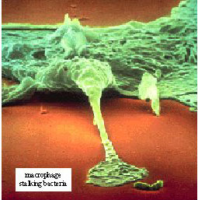
Our immune systems attack bacteria
Here is a white blood cell attacking a bacillus

Slide 43
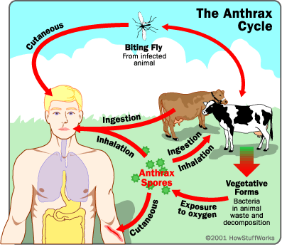
Diseases caused by bacteria
Anthrax – a natural pathogen that can be used for bioterrorism

Slide 44
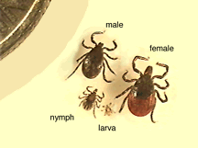
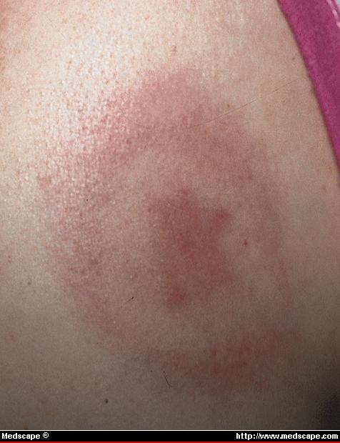
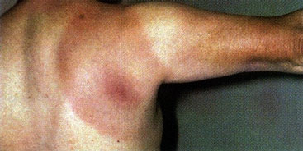
Lyme disease – causes illness and can lead to arthritis

Slide 45
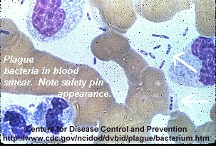
gonorrhea
plague
Strep throat

Slide 46

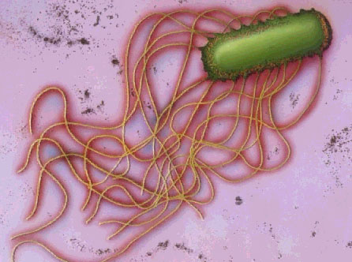
Food poisoning
Botulism – from improperly canned foods
Salmonella →food poisoning – from eggs, chicken, mayonnaise

Slide 47
Tuberculosis
caused by the bacteria
  Mycobacterium tuberculosis
Can be inhaled as droplets from cough or sneeze from infected person = Primary TB –most recover
infection may stay asleep or inactive (dormant) for years. However, in some people it can reactivate.

Slide 48
TB Symptoms
Cough (usually cough up mucus)
Coughing up blood
Excessive sweating, especially at night
Fatigue
Fever
Unintentional weight loss
Other symptoms that may occur with this disease:
Breathing difficulty
Chest pain

Slide 49
TB Treatment
A patient may need to take many different pills at different times of the day for 6 months or longer.
  Treatment of active pulmonary TB will always involve a combination of many drugs (usually four drugs).
The most commonly used drugs include:
  Isoniazid, Pyrazinamide , Rifampin, and
  Ethambutol
DOT: when a health care provider watches the person take the prescribed drugs. =Directly Observed Therapy

Slide 50
Bacterial “Pathogenesis’
How do bacteria cause disease?
Transmission
Colonization and Growth
Invasion of Tissue
  Producing inflammation
  Producing toxins

Slide 51
Transmission
Often from reservoirs: soil, food, water
Most often from other humans or animals
PREVENTION: The key is to recognize the means of transmission and break the chain!
Notes:
Ex. Removing the pump handle on the Broad St Pump broke the chain of transmission in the London cholera outbreak!
Ex. Removing the pump handle on the Broad St Pump broke the chain of transmission in the London chlera outbreak!

Slide 52
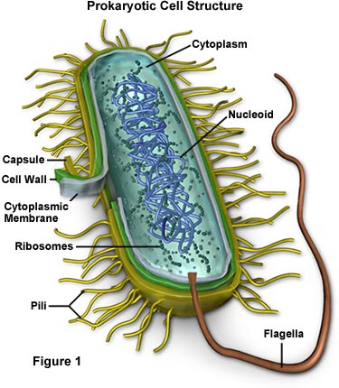
Colonization and Growth –
2 cell parts needed for this step!
Capsule
  Prevents neutrophils (WBC) from phagocytosing the bacterium.
  No capsule/no disease. Bacteria will be engulfed and destroyed.
Pili (sing. Pilus)
Allow bacteria to attach to the surface of our cells. No pili/no disease.

Slide 53
Steps in colonization and growth
Attaches by pili
  Capsule protects from neutrophils (Immune cells) =slimy sugary coating around cells– helps cells adhere to a surface – like plaster.
  =Glycocalyx( another name for capsule) -
Biofilm forms over bacterial mat – protecting it from antibiotics and from neutrophil attack. (Your body will eventually make antibodies against the bacteria)

Slide 54
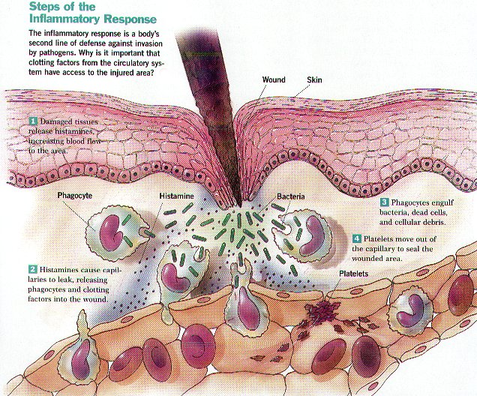
Inflammatory Response

Slide 55
Toxins:
These are primary source of illness as a result of infection
2 types:
Endotoxin –G- bacteria
Exotoxin – G+ and G- bacteria

Slide 56
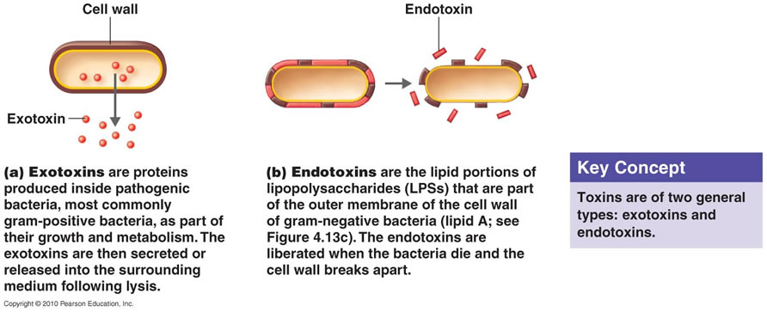
Endotoxins and Exotoxins

Slide 57
ENDOTOXINS (G- only)
=Lipopolysaccharides , LPs, located in cell wall of bacteria
Released when Bacterial cell dies: as result of host’s immune response or antibiotics.
Acts in vicinity of bacterial growth or presence in host.
  =Major cause of death: Septic Shock: fever, shock, (hypotension/low blood pressure), and disseminated intravascular coagulation, (DIC), = clots that form in capillaries that prevent oxygen from getting into tissue cells.
Notes:
Endotoxins activate macrophages to → shock symptoms and initiate the coagulation cascade

Slide 58
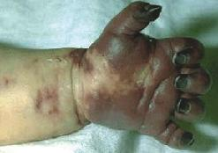
Meningococcemia
G- bacteria w/ endotoxin
B/c of millions of tiny clots in capillaries
Will lead to gangrene and loss of fingers

Slide 59
Exotoxin
=Protein
Produced by G+ and G- bacteria
  virulent strains bacteria → toxin while non-virulent strains do not.
Toxin is secreted by the living bacteria
Generally act at a site removed from where bacteria grow. – specific for toxin…
  Names indicate tissue acted upon”Neurotoxin, hemolysin

Slide 60
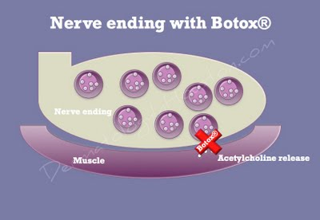
EXOTOXIN (cont’d)
Bolulinum toxin– prevents neurotransmitter release from neuromuscular junctions →
  ‘flaccid paralysis’
“BOTOX” uses botulinum toxin - muscle relaxes and smoothes out skin to eliminate wrinkles.
Botulinum toxin is THE MOST toxic substance known. – molecule for molecule

Slide 61
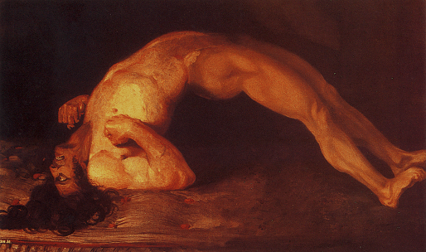
Tetanus - spastic paralysis
Exotoxin produced in spinal cord
Neurons normally act to excite some muscle and relax opposing paired muscle.
  Prevents inhibitory neurons from acting so only excitatory neurons are enacted. Extensor muscles of back are in spasm

Slide 62
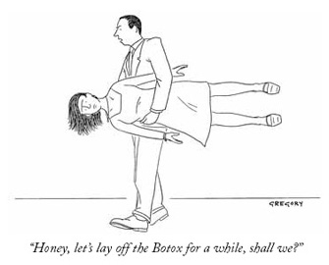
What’s wrong with this cartoon??

Slide 63
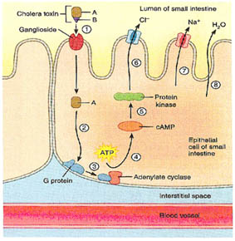
Cholera Exotoxin
Cholera is located in the intestinal lumen
binds to surface of cell and stimulate a cell signaling molecule to be on constantly.
Result is that ion ‘gates’ to open so water, Na and Cl leave
tissue → dehydration.

Slide 64


Cholera
Symptoms of this Infection
- Watery Diarrhea
- Vomiting
- Dehydration
- Electrolyte imbalance
- Low blood pressure
- Wrinkled hands
- Poor skin turgor
- Sunken eyes
- Rapid pulse
- Fever/chills

Slide 65
Injection of Exotoxin INTO cells
Much more virulent than others.
  An example of an injected exotoxin is the Bacillus anthracis toxin.
Anthrax actually secretes 3 toxins,
  I. edema factor,
  II. protective antigen and
  III. lethal factor.
The Factor II (protective antigen) is responsible for getting the other 2 toxins into the cell.
Notes:
Anthrax toxin causes hemorrhage and necrosis of lymph nodes and internal tissues. Inside cells, they disrupt cell communication, immune response and may cause lysis. All 3 are needed for lethality!

Slide 66
How can ordinary E.Coli become pathogenic?
By acquiring new genes via plasmids or phage
(see genetic recombination)
Can cause watery diarrhea (Montzuma’s revenge)
E.Coli on spinach – acquired different DNA that encodes hemolytic uremic syndrome – bloody diarrhea.
Urinary tract infections – caused by E.coli strain that has new genes that allow it to attach to urinary tract wall
Neonatal meningitis – different DNA has capsule that endow it with ability to cause this disease.

Slide 67

  We combat disease-causing bacteria with Antibiotics.
    1. Most antibiotics are from fungi, which have waged a war of survival with bacteria for millions of years.
    2. Antibiotics must exploit differences in cell biology of bacteria and humans to keep from harming patient (e.g., penicillin prevents production of bacterial cell walls, but has no effect on animal cells).

Slide 68

Antibiotics act to prevent bacteria from building materials needed to survive.

Slide 69

More specifically….

Slide 70

Antibiotics, when placed on a paper disc, inhibit growth of bacteria in Petri dishes…. The larger the zone of inhibition, the more effective the antibiotic is.
Zones of Inhibition
Least effective most effective

Slide 71
Antibiotic Resistance
When people do not take their TB medications as recommended, the infection becomes much more difficult to treat.
The TB bacteria may become resistant to treatment, and sometimes, the drugs no longer help treat the infection.
How does this occur?
  by Natural Selection of the bacteria that bear resistance genes!

Slide 72

Antibiotic Resistance through Natural Selection

Slide 73

Medical uses of bacteria
Genetic engineering to produce medical products –
  Insulin
  Human growth hormone
Gene for human insulin or hgh
Now all cells will have the gene and will make the product

Slide 74
New ideas for Medical uses of bacteria- Phage Therapy
Phages – attack only bacteria and are ubiquitous.
As more and more bacteria become antibiotic resistant, we are making stronger and stronger antibiotics to keep up. Many have side effects or may be toxic.
Now companies are developing phages that kill bacterial strains resistant to the most powerful antibiotics.
In Canada, phage treatments are offered to be administered on vegetables to kill bacteria that cause food poisoning.

